Slide 1
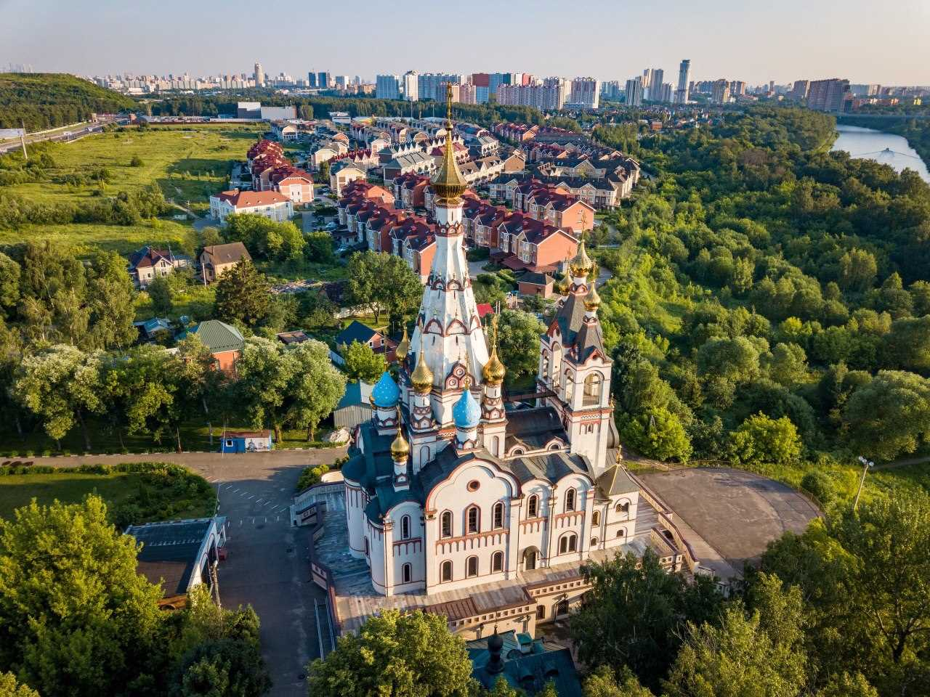

CITY DISTRICT DOLGOPRUDNY MOSCOW REGION
Main economic indicators
INVESTMENT POTENTIAL
The area of the urban district is 3052 hectares
Population over 120 thousands of people
69.7 thousand people - working population
The volume of shipments of large and medium-sized enterprises and organizations of the city is
78.2 billion rubles
6.9 thousand business entities
195 large and 15 medium enterprises and organizations
2.4 thousand small and micro enterprises
City administration Dolgoprudny, Moscow region

Slide 2
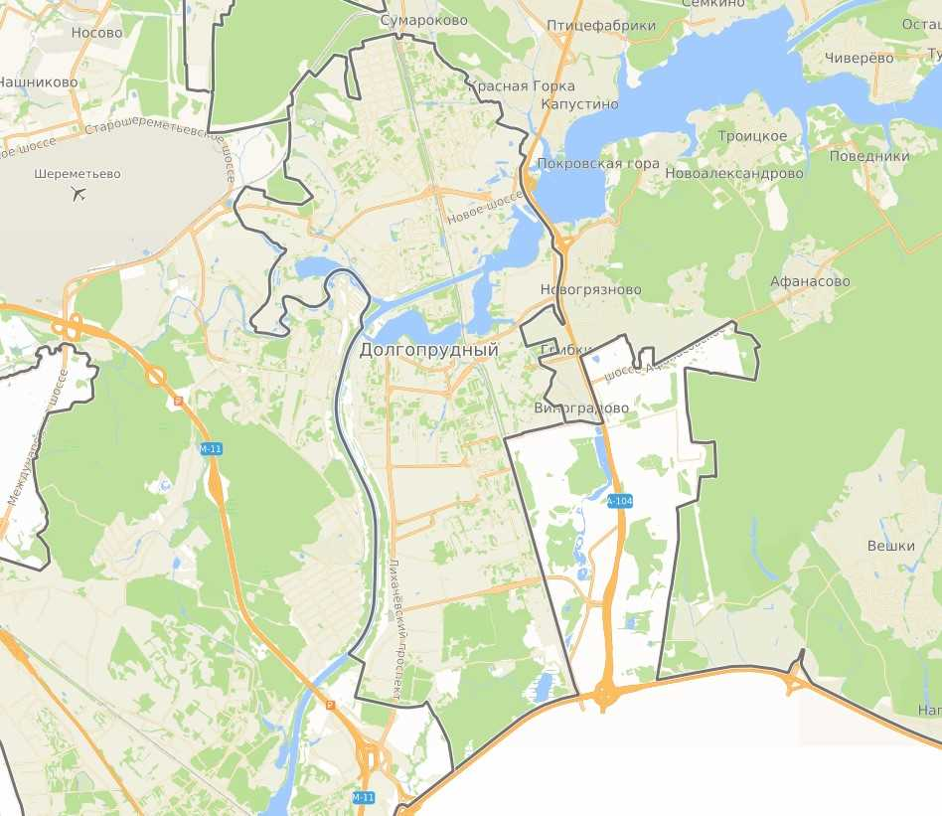
CITY DISTRICT DOLGOPRUDNY MOSCOW REGION
COMPETITIVE ADVANTAGES
TRANSPORT
AVAILABILITY
Dolgoprudny urban district
located 18 km north by rail from Savyolovsky station
proximity to Moscow - 3 km from MKAD
proximity to SHEREMETYEVO AIRPORT - 7.5 km .
proximity to the Lobnya railway depot (up to 10 km)
proximity to the waterway - Canal named after. Moscow
Dolgoprudny borders the municipal districts of Mytishchi , Lobnya and Khimki, adjacent to the Moscow Federal Ring Road (MKAD)
access to Leningradskoe and Dmitrovskoe highways is provided
There are 5 MCD stations available on the territory of the Dolgoprudny district - Sheremetyevskaya, Khlebnikovo, Vodniki, Dolgoprudnaya , Novodachnaya
In 2023, the Fiztekh metro station was opened in Dolgoprudny (the final station of the Lyublinsko-Dmitrovskaya line ). “Fiztekh” has become the fifth station of the Moscow metro, which residents of our city can reach by public transport
Developed research and production complex, high level of scientific and intellectual potential
Highway A-104 (Moscow-Dubna)
Highway M-11 (Moscow-St. Petersburg )
MKAD

Slide 3



CITY DISTRICT DOLGOPRUDNY MOSCOW REGION
Personnel potential
Population
and labor market
The main labor specialization of city residents
Salary level of large and medium-sized enterprises and organizations
Population - 120 thousand people
(as of 01/01/2023)
Population of working age - 58 %,
60 % of which are employed in the city’s economy (of the working population)
28.9 thousand people - a personnel reserve of qualified labor due to labor migration
0.25% - level of registered unemployment (average for the Moscow region - 0.25%)
Industry – 8.5 thousand people
Science – 2.7 thousand people
Education – 7.3 thousand people
Healthcare - 3.2 thousand people
Transport and communications – 5.5 thousand . Human
Construction - 1.1 thousand people
Household services , trade and services – 7.7 thousand people
Public administration , military security and social security - 0.9 thousand people
Financial and insurance activities, real estate activities - 0.4 thousand people
Science and technology – 126.5 thousand rubles.
Manufacturing industries - 92.8 thousand . rub .
Education – 110.5 thousand roubles .
Culture and sports – 73.7 thou . rub .
Health and social services – 59.2 thousand roubles .
Informatization and communication –
103.7 thousand roubles .
Trade, services – 92.0 thousand roubles.
Transportation and storage –
81.2 thousand roubles.
Hotels and catering
- 49.4 thousand roubles .
Construction – 27.5 thousand roubles.

Slide 4

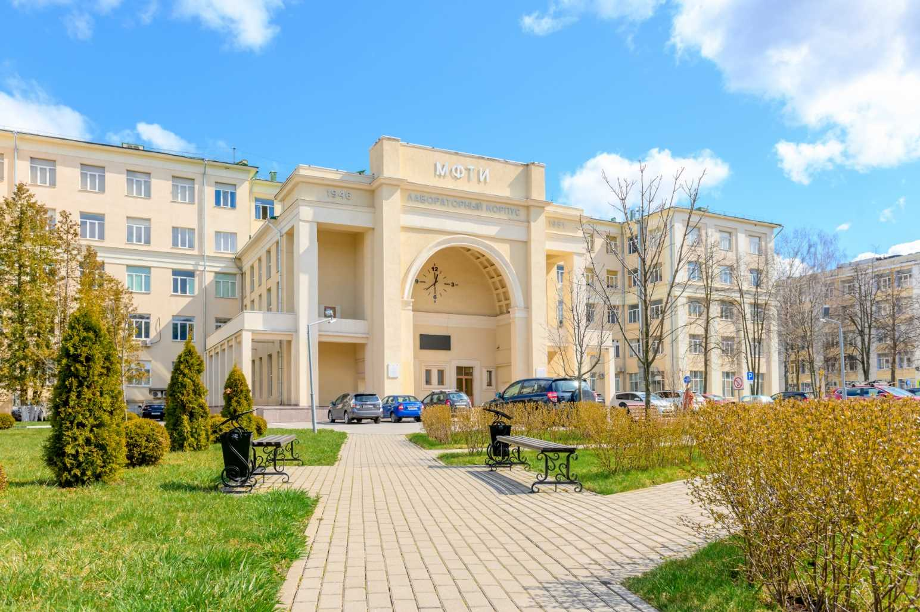
CITY DISTRICT DOLGOPRUDNY MOSCOW REGION
Moscow Institute of Physics and Technology (Phystech) is one of the country's leading technical universities and is included in the main rankings of the best universities in the world. The Institute has not only a rich history, but also a large research base
Education and qualified personnel
MIPT today:
1st place in the ranking of universities for the quality of training specialists in the field of artificial intelligence
10 Nobel laureates
more than 90 teachers - corresponding member.
and academicians of the Russian Academy of Sciences
about 6000 doctors of science
more than 17,000 candidates of science
more than 7,000 students from 28 countries
more than 64 scientific laboratories
Development plans:
Concentrate resources on promising areas of research
Attracting new scientists to leading positions in campus laboratories
Involving researchers from new laboratories in the educational process

Slide 5
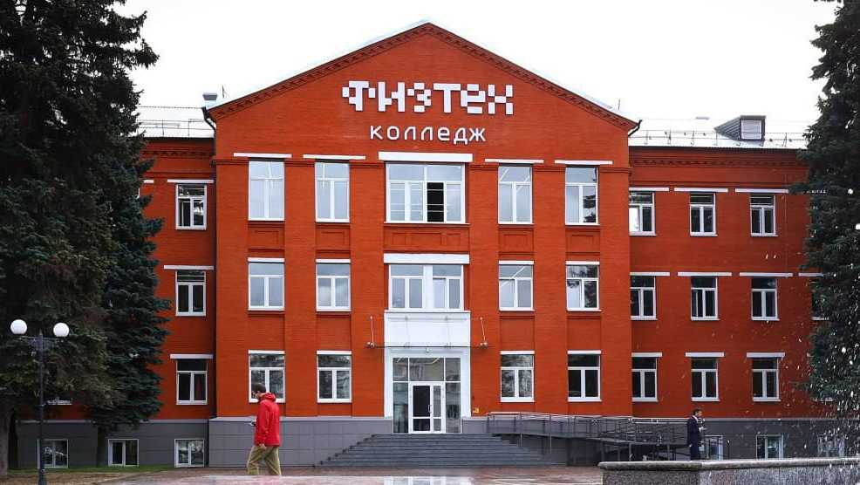
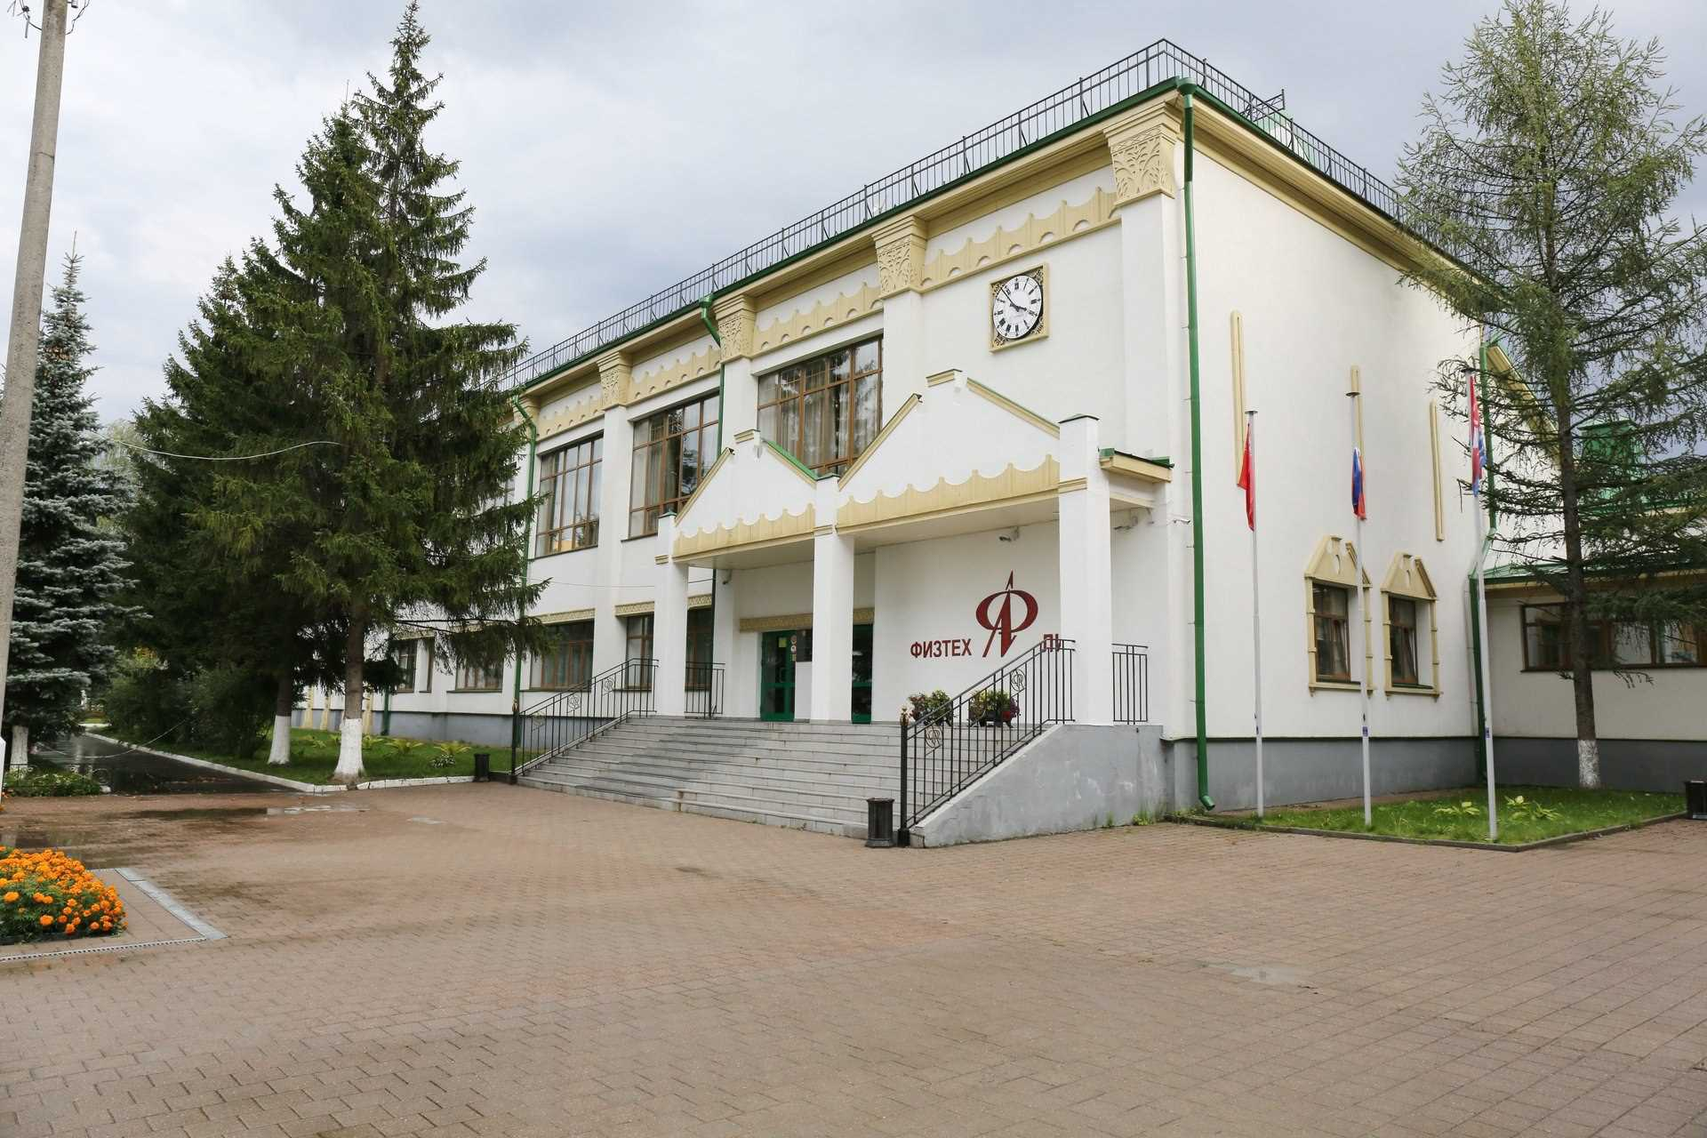

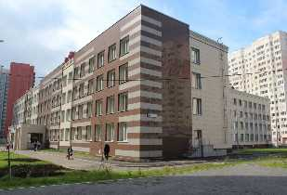
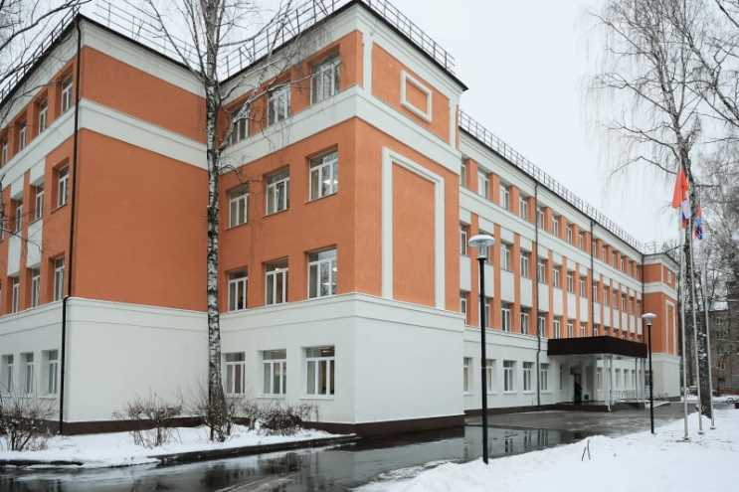

CITY DISTRICT DOLGOPRUDNY MOSCOW REGION
HIGHER EDUCATION
Federal State Autonomous Educational Institution of Higher Education " Moscow Institute of Physics and Technology (National Research University )" (MIPT)
SECONDARY VOCATIONAL EDUCATION
GBPOU MO " Phystech College"
GENERAL AND PROFESSIONAL EDUCATION
ANOO "Phystech-Lyceum" named after. P.L. Kapitsa
Specialties and professions:
Network and system administration, Information systems and programming, Operation of unmanned aircraft
systems , production and service
aviation equipment , etc.
BASIC/SECONDARY GENERAL EDUCATION
11 general education municipal institutions
2 state educational institutions: ANOO "Phystech-Lyceum" named after. P.L. Kapitsa, State Autonomous Educational Institution "Dolgoprudnenskaya Gymnasium"
3 private schools: ANO Secondary School "SODRUSHESTVO", CHNOU "School "Dashenka", OJSC "Phystech-nachalo"
State Autonomous Educational Institution "Dolgoprudnenskaya Gymnasium"
MAOU Physics and Mathematics Lyceum No. 5
Top best schools in the Moscow region in 2023
Place in the ranking | Educational institutions
Education | ANOO "Phystech-Lyceum" named after. P.L. Kapitsa is the absolute leader in education in Moscow Region in 2023
1 place | MAU Dolgoprudny Physics and Mathematics Lyceum No. 5
22nd place | MAOU secondary school No. 16
25th place | State Autonomous Educational Institution "Dolgoprudnenskaya Gymnasium"
PRESCHOOL EDUCATION
6 municipal kindergartens
11 private kindergartens
68th place | MAOU secondary school No. 14

Slide 6





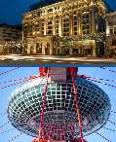






CITY DISTRICT DOLGOPRUDNY MOSCOW REGION
SYSTEM-FORMING PRODUCTION ENTERPRISES
PJSC "Dolgoprudny Research and Production Enterprise" ("PJSC "DNPP") - the largest industrial enterprise in the city.
The main volume of DNPP production is made up of products under long-term export contracts within the framework of military-technical cooperation (MTC )
Website: www.dnpp.biz
JSC Dolgoprudny Automation Design Bureau (JSC "DKBA") is the only state-owned enterprise in Russia engaged in the development and creation of airships, balloons , and special-purpose systems
The main activities of DKBA are:
Conducting research and creating promising complexes of aeronautical equipment, including airships, free and tethered balloons, as well as the development of structural film, fabric-film materials, ground handling systems and on-board power transmission, to solve the problems of communication relay, radar patrol, and training work
development and production of fire alarm systems and means installed on airplanes and helicopters, on sea and river vessels, as well as at pumping compressor stations of Gazprom Russia enterprises
development and production of soft structures for special purposes
Website: www.dkba.ru
Mosavtosteklo LLC - one of the oldest glass industry enterprises
Enterprise specialization
Glass products for aviation and military equipment
Electric heating products for automobile and railway transport
Tempered flat glass for glazing of ground transport, glazing of passenger cars, shop windows and stained glass windows, glazing of building facades, stair railings
Double-glazed windows for glazing vehicles, facades, buildings, structures and translucent roofs.
Construction triplex, which is used for glazing building facades, balconies, stair railings, shop windows, etc.
Website: www.mosavtosteklo.ru

Slide 7























CITY DISTRICT DOLGOPRUDNY MOSCOW REGION
Operating enterprises
in the areas
INDUSTRY SCIENCE
LOGISTICS
JSC "Research Institute of Organic Intermediates and Dyes"
PJSC "Dolgoprudny Research and Production Enterprise"
Federal State Autonomous Educational Institution of Higher Education "Moscow Institute of Physics and Technology (National Research University)"
FSBI " Central Aerological Observatory"
JSC Dolgoprudny Automation Design Bureau
Association for the Development of the Biopharmaceutical Cluster "Northern"
JSC Prime Print Moscow
JSC "Proizvodstvennoe
Association "TOS"
CJSC "FM Logistic Vostok"
JSC Khlebnikovsky Machine-Building and Ship Repair Plant
TRICOR LLC/ROCKET LLC
Mosavtosteklo LLC
JSC Pharmstandard
LLC "DPS"
LLC "Format"
LLC "DOL-HLEB"
LLC "Dental-cosmetic-rus"
NOU "Educational-research-production complex of the Moscow Institute of Physics and Technology"
LLC "SvarMontazhStroy"
LLC "Clean Line"
Betas
LLC "AlexAnn"
Helvet LLC
LLC "PHYSICON"
Physicon Lab LLC
LLC "Moscow Stone Processing Plant"
About LLC "SP AUTOMATIKA"

Slide 8
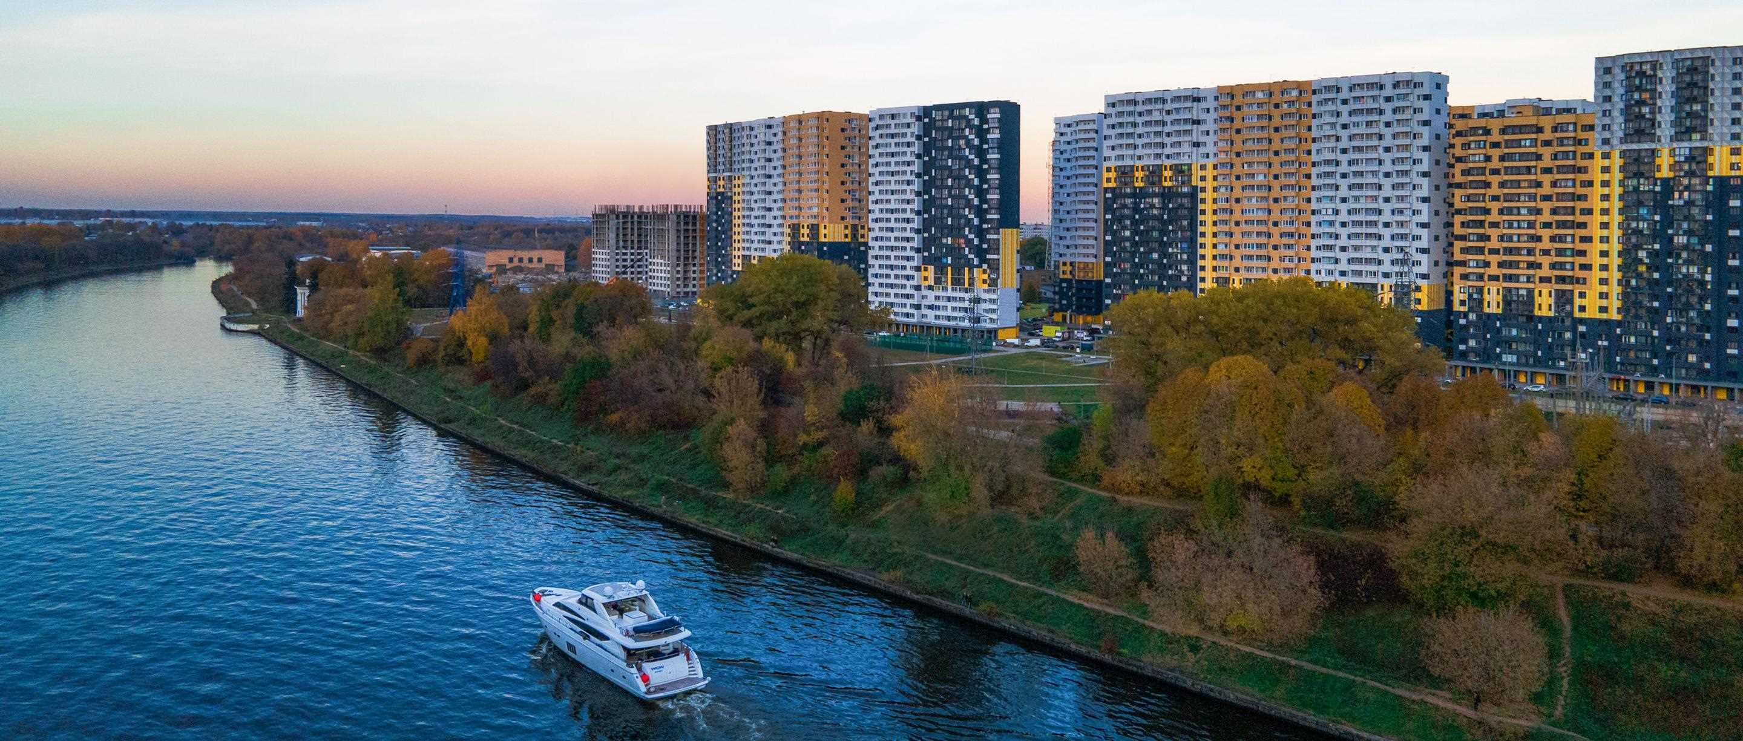
CITY DISTRICT DOLGOPRUDNY MOSCOW REGION
ENERGY RESOURCES CADASTRAL VALUE
The cost of energy resources in the city of Dolgoprudny
electricity
5.05/6.73 rub. for 1 kWh , including VAT (electric stove/gas stove)
gas supply
7.85 rubles/cube . m , with VAT
water supply
49.14 rubles per 1 cubic meter . m , with VAT
drainage
RUR 35.29 for 1 cubic meter m with VAT
heat supply
RUB 2,027.28 /Gcal, including VAT (MUP “Engineering Networks”)
Cadastral value of land plots*
for placement of industrial facilities 5178 rub. per sq. m
administrative and office facilities 8880 rub. per sq. m
retail facilities 9980 rub. per sq. m
road service facilities RUB 9,218 per sq. m
hotels 4156 rub. per sq. m
tourism (recreation) 5059 rub. per sq. m
mid- and high-rise residential buildings RUB 11,904 . per sq. m.
low-rise residential buildings and individual housing construction RUB 5,954 . per sq. m
* Average values are indicated in accordance with the order of the Ministry of Property Relations of the Moscow Region 11/28/2022 N 15ВР-2452 “On approval of the results of determining the cadastral value”

Slide 9
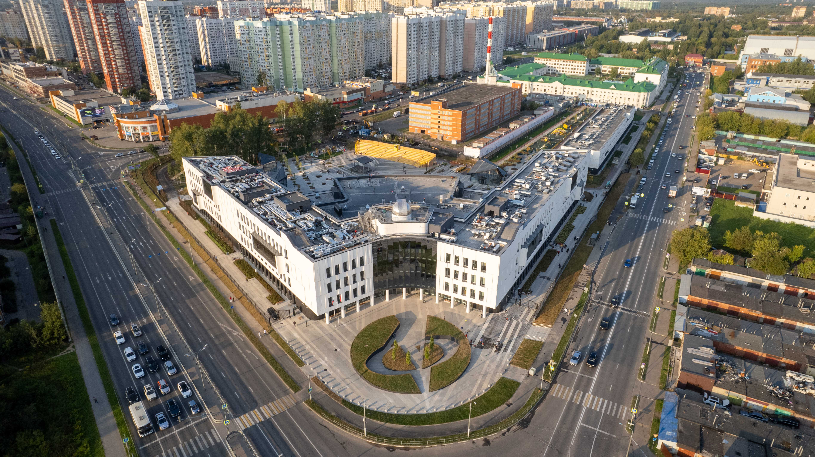
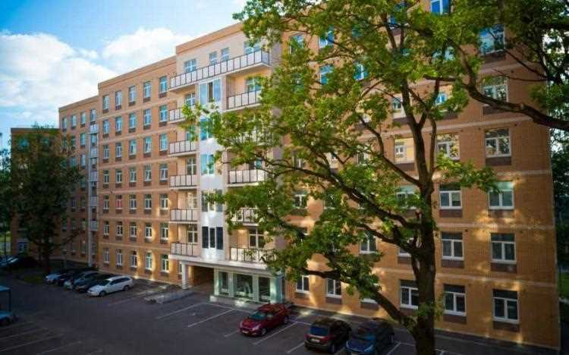




CITY DISTRICT DOLGOPRUDNY MOSCOW REGION
INFRASTRUCTURE TO SUPPORT ORGANIZATIONS AND INNOVATION
FOCUS AND SME ENTITIES
TECHNOPARK PHYSTECH-LYCEUM
THEM . P.L. KAPITSY
International science school cluster . Representatives of business projects and laboratories are invited to cooperate. They can open their own educational laboratory or research center in the Technopark and, as part of their training, involve schoolchildren in production activities, preparing a base of qualified personnel for business or the industry as a whole.
TECHNOPARK "LIKHACHEVSKY "
Comfortable environment for innovative business:
- 2000 jobs,
- 200 residents
A large business complex, the advantage of which is walking distance from MIPT, one of the leading Russian universities .
The total area of the technology park facilities is 36,689.8 square meters. meters.
Location: Moscow region, Dolgoprudny, Letnaya street, 2. Contacts: tel . +7 (917) 521-23-47 , e-mail: info@kapitsa.center , website: https://kapitsa.center /
Location: Dolgoprudny, Likhachevsky proezd, 4, building 1; d.6, p.1; d.8.
Contacts: tel. + 7 (495) 765-05-79, e-mail: linkinproject@yandex.ru , website : http:// www.lihachevsky.com
A separate division of the Union "Chamber of Commerce and Industry of the Moscow Region" (CCI) - represents the interests of small, medium and large businesses, all areas of entrepreneurship - industry, domestic and foreign trade, agriculture, financial system, services.
Location in the city of Dolgoprudny: Patsaeva Ave. , 7, building 1; tel.:8(916)328-72-70, mun_dolgoprudny@tppmo.ru
Public representative of the Chamber of Commerce and Industry Kiseleva Svetlana Vitalievna 8(916)328-72-70
Biopharmaceutical cluster "Northern" About the unification of leading enterprises of the Russian pharmaceutical and medical industry, research institutes and medical institutions, small innovative companies http://pharmcluster.ru

Slide 10
CITY DISTRICT DOLGOPRUDNY MOSCOW REGION
MEASURES OF GOVERNMENT SUPPORT FOR BUSINESS
Land plot for rent for 1 ruble for the purpose of placing import-substituting production
https://invest.mosreg.ru/business/support-measures/industry/property-support/1721/ _
Providing land plots for rent without tendering for the implementation of large-scale investment projects
https://invest.mosreg.ru/business/support-measures/investor/property-support/1250/ _
Preferential lending programs for SME Corporation
https://corpmsp.ru/bankam/programma_stimulir/ _ _
Russian Industrial Development Fund
https://frprf.ru/zaymy/ _ _
Subsidy to compensate for the costs of creating engineering infrastructure for industrial enterprises
https://invest.mosreg.ru/business/support-measures/industry/financial/1253/ _
Subsidy interest rate on a bank loan from the Moscow Region for import-substituting production projects
https://invest.mosreg.ru/business/support-measures/sme/financial/1270 _
Subsidy for SMEs for the purchase of equipment
https://invest.mosreg.ru/business/support-measures/industry/financial/1253/ _

Slide 11
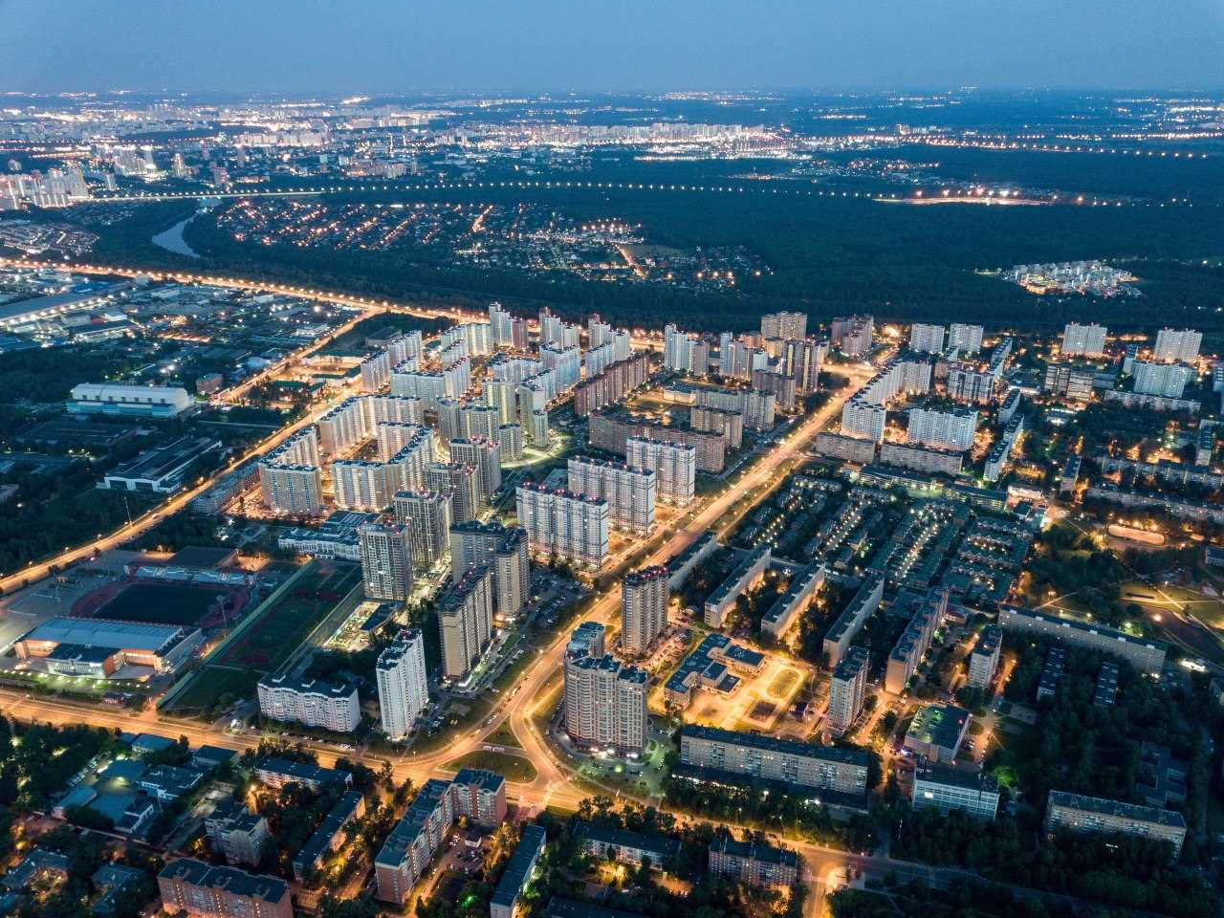
CITY DISTRICT DOLGOPRUDNY MOSCOW REGION
Investment activity indicators (forecast for 2023)
INVESTMENT PASSPORT
Volume of investments from all sources of financing – 11.8 billion rubles
The volume of investments attracted into fixed capital (excluding budgetary investments), per capita – 60.75 thousand rubles
Number of jobs created (for the full range of enterprises) - 3,500 new jobs

Slide 12
CITY DISTRICT DOLGOPRUDNY MOSCOW REGION
PROMISING INDUSTRIES FOR BUSINESS DEVELOPMENT
No. | Name | Location | Description
1 | Research and development | Territories of scientific and technical sites: MIPT, FSUE "SSC "NIOPIK", FSBI "CAO", JSC DKBA", Technopark "Likhachevsky", Industrial Park "TOS" | In Dolgoprudny, fundamental and applied research is carried out in the field of radiophysics, radio engineering, physical and quantum electronics, biomedical radio electronics and computer science, radar research of the earth, ocean, and space. High level of scientific and intellectual potential: the country's largest defense enterprise PJSC DNPP (Almaz Antey concern) MIPT leading scientific center in the field of chemistry, technology for the production and use of fine organic synthesis products FSUE "SSC "NIOPIK" leading research organization of Roshydromet, Federal State Budgetary Institution "Central Administrative District" one of the main developers and creators of new types of aeronautical equipment (including airships, free and tethered balloons) JSC "DKBA" Availability of infrastructure for the creation of innovative projects: industrial park "TOS", technology park "Likhachevsky"
2 | The sphere of education and the formation of a research and educational center | Creation of a unified educational, scientific and business space on the basis of MIPT for existing and newly created companies in the field of high technologies, focused on the personnel potential of Physics and Technology - “University City”. Southern part of the urban district | The presence of one of the best higher educational institutions in the Russian Federation - MIPT, a powerful research and production complex, a strong system of secondary and secondary specialized education: Physics and Technology College, Physics and Technology Lyceum named after P.L. Kapitsa, Dolgoprudnenskaya gymnasium, 11 schools. At the end of 2019, three schools in the city are included in the TOP 5 best schools in the region. The presence of certain basic elements of the innovation structure: innovation and technology centers, technology transfer centers, business incubators, technology parks (Technopark of the P.L. Kapitsa Physics and Technology Lyceum - an international natural science school cluster), including at MIPT, foundations, specializing in supporting innovative entrepreneurship, including public and private, etc. The “education-science-production” chain has been introduced Conditions have been created for the development of innovative entrepreneurship and support for small and medium-sized businesses.
3 | Pharmaceutical and chemical industry | Territories of industrial sites: FSUE "SSC "NIOPIK", Industrial Park "TOS" on the basis of the existing enterprise JSC "PA "TOS", Pharmstandard JSC, MIPT | The key factors of competitiveness of the pharmaceutical industry include: - developed production base; — a strong scientific and technical base, due to the presence of large research organizations and enterprises in the region. Anchor enterprises and organizations operating in the city: FSUE “SSC “NIOPIK”, JSC “Pharmstandard”, JSC “PO TOS”, The presence of leading MIPT laboratories, where world-famous scientists work. They work on aging and age-related diseases, applied and fundamental physics, nano-optics, quantum computing, photonics and much more.

Slide 13
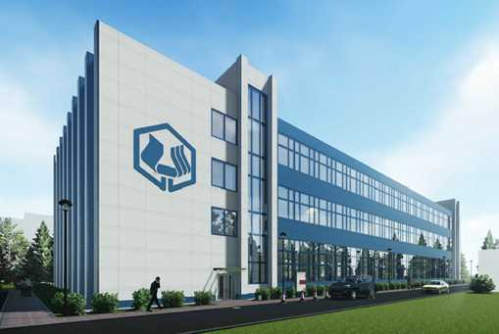
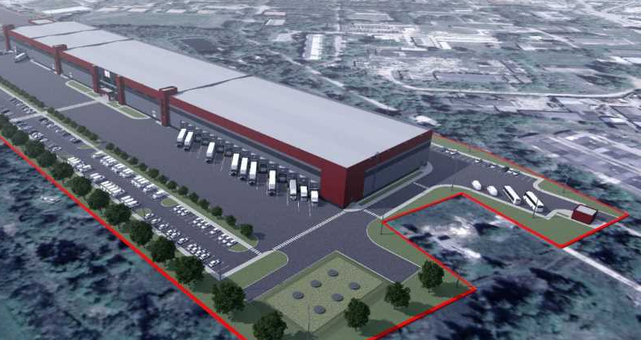
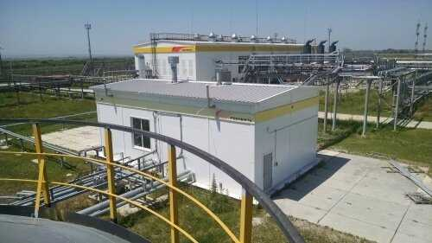
CITY DISTRICT DOLGOPRUDNY MOSCOW REGION
2023 _
LARGE INVESTMENT PROJECTS ONGOING
in the industrial sector
Reconstruction, technical re-equipment of the building of the plant-research center of JSC "NIOPIK " :
Construction of a new high-tech milk processing plant, LLC "Clean Line "
Construction of a new production and warehouse building (pump production)
LLC "KURS-CONSULTING"
Project implementation timeframe | 2017-2024
Amount of investment | 3500 million rubles.
Number of new jobs created | 109
Location | Dolgoprudny, Likhachevsky pr-d, 7
Project implementation timeframe | 2023-2025
Amount of investment | 2500 million rubles.
Number of new jobs created | 500
Location | Dolgoprudny, st. Eastern
Project implementation timeframe | 2022-2023
Amount of investment | 150 million rubles.
Number of new jobs created | 15
Location | Dolgoprudny, Likhachevsky pr-d, 26

Slide 14
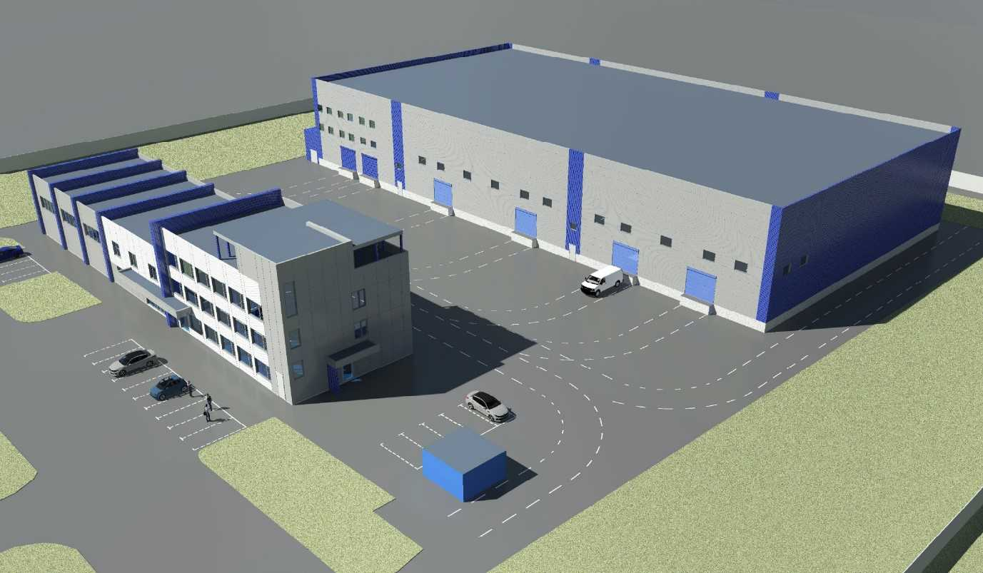
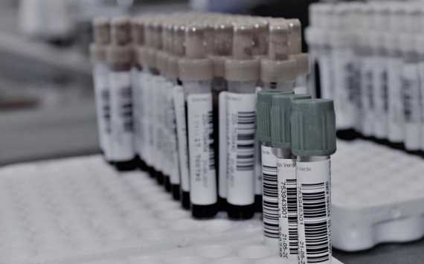
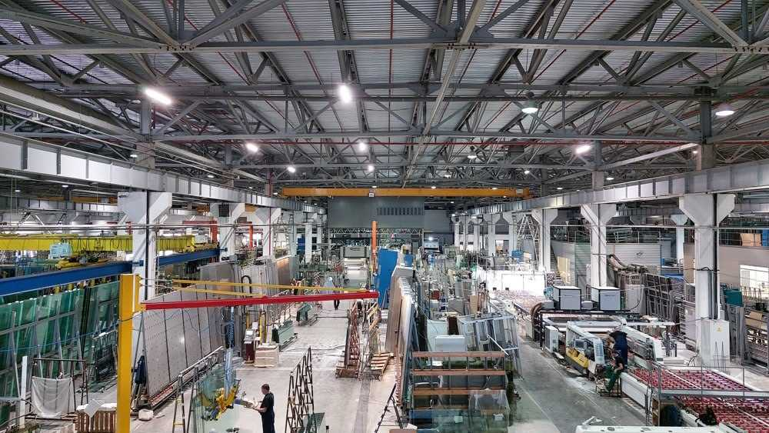
CITY DISTRICT DOLGOPRUDNY MOSCOW REGION
2023 _
INVESTMENT PROJECTS FOR IMPORT SUBSTITUTION
Land plots were provided under the “Land for 1 ruble” program
Construction of a production and warehouse complex for the production of components for freight vehicles
LLC "UDT-TEHNIKA"
Organization of high-tech production of pharmaceutical substances for highly active drugs Globalkhimpharm
Construction of a production and warehouse complex for processing sheet glass for railway cars, aircraft, buildings
LLC "TD MOSAVTOSTEKLO "
Project implementation timeframe | 2021-2025
Amount of investment | 135 million rub.
Number of new jobs created | 51
Location | Dolgoprudny, Stroiteley passage, western side of LTU-94
Project implementation timeframe | 2022-2026
Amount of investment | 751 million rub.
Number of new jobs created | 120
Location | Dolgoprudny, st. Eastern, Stroiteley passage
Project implementation timeframe | 2022-2025
Amount of investment | 500 million rubles.
Number of new jobs created | 40
Location | Dolgoprudny, microdistrict Khlebnikovo

Slide 15
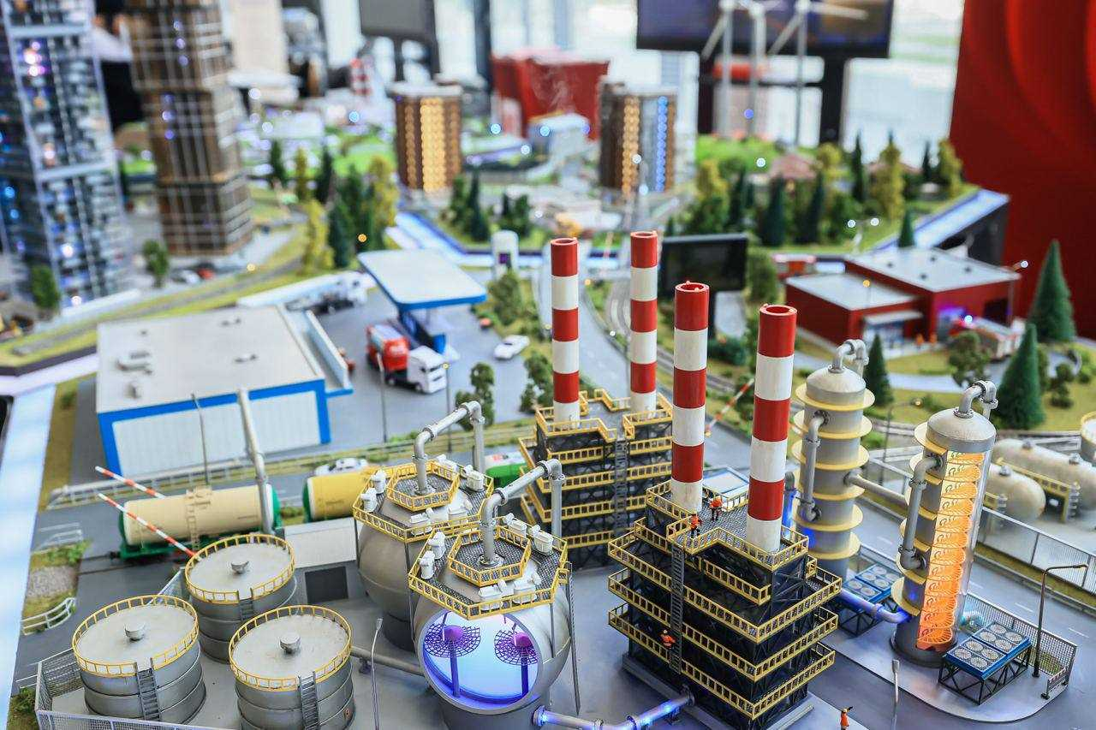
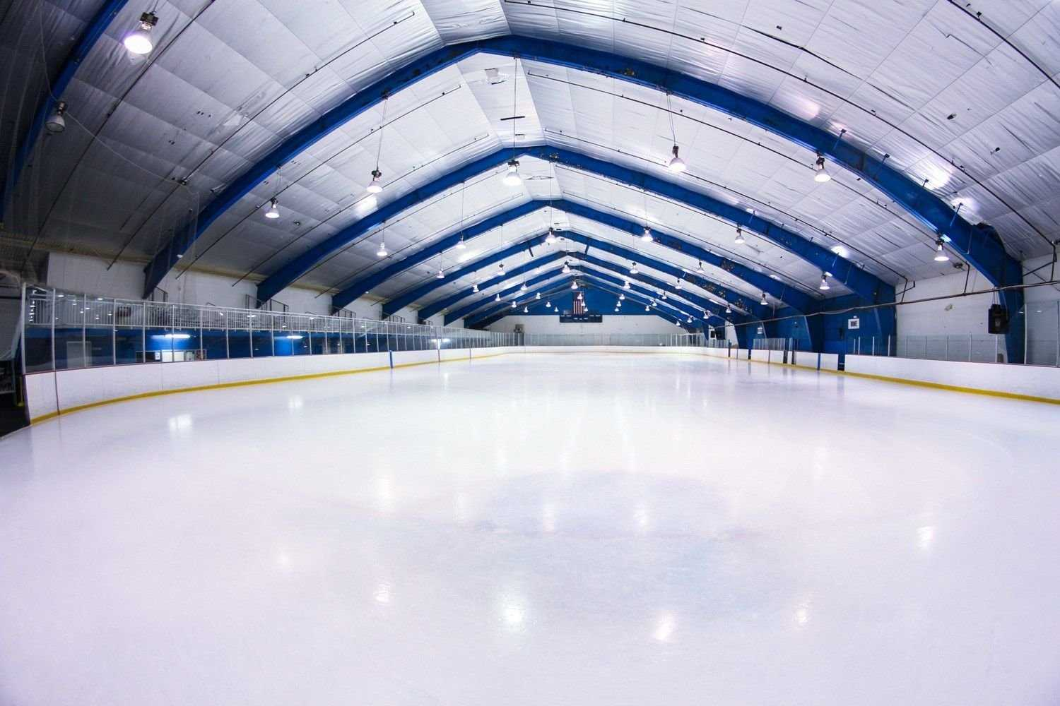
CITY DISTRICT DOLGOPRUDNY MOSCOW REGION
2023 _
PROMISING INVESTMENT PROJECTS
Large-scale investment project for the construction of a hotel with an adjacent theme park with an area of about 15 thousand square meters , landscaping of the park
Phystechland LLC (land plot with an area of 4.2 hectares, provided as part of the support of large-scale investment projects for rent (without bidding). The hotel will be able to accommodate students and graduates of MIPT and PhystechLyceum, conference participants, residents and employees of technology parks, as well as all those who wish.
Construction of a sports complex with ice and football arenas
Valdai Tour
Project implementation timeframe | 2023-2025
Amount of investment | 250 million rubles.
Number of new jobs created | 60
Location | Dolgoprudny, Beregovoy proezd
Project implementation timeframe | 2023-2030.
Amount of investment | 1513 million rubles.
Number of new jobs created | 39
Location | Dolgoprudny, Likhachevsky Avenue

Slide 16
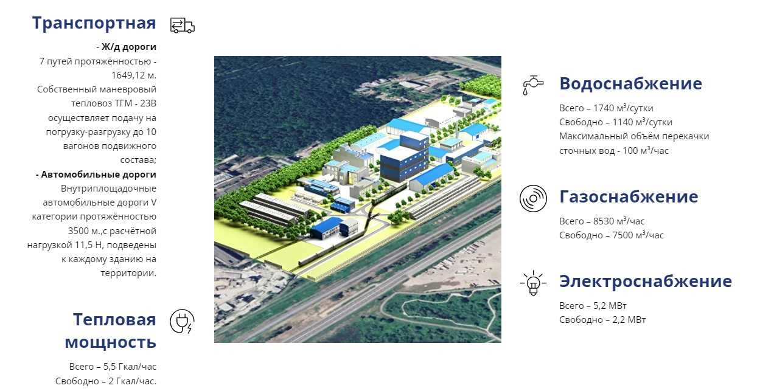
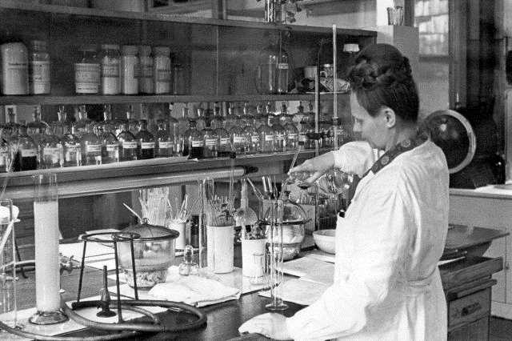
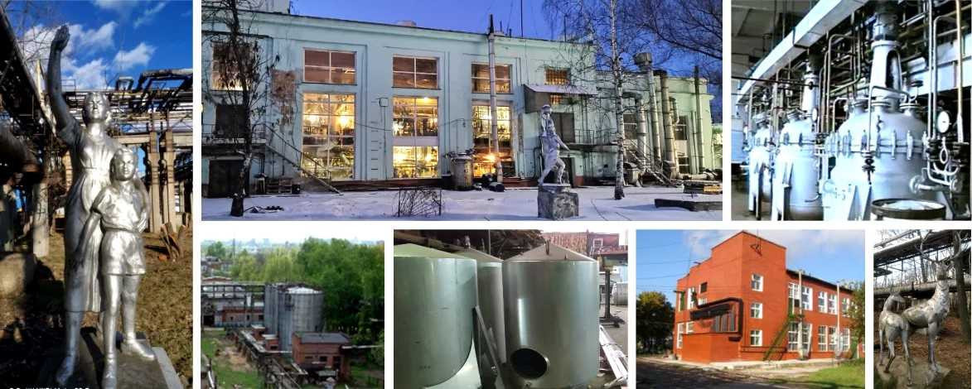
CITY DISTRICT DOLGOPRUDNY MOSCOW REGION
INDUSTRIAL CHEMICAL PARK "TOS" (IP "TOS")
accredited by the Ministry of Industry and Trade of the Russian Federation in 2023
IP "TOS" appeared as a result of the renovation of the industrial site of a large enterprise of the Soviet chemical industry - OJSC PO "Tonkiy Organicheskiy Synthesis".
For park residents – there are premises for storing liquid chemical products, as well as a chemical laboratory and infrastructure for R&D.
Total area of the park | 17.82 ha
Building area | 7.47 ha
Available area | 11,513 sq.m.
Occupied area | 9,534 sq.m.
Residents of the industrial park are offered both existing space and the construction of new buildings on a turnkey basis .
Promising sites for development: 2500 sq.m. and 3000 sq.m.
Companies can accommodate in buildings with a free area of more than 15 thousand square meters, there are open spaces of 4.21 hectares.
Advantages of the park : good infrastructure, transport accessibility, including
railway tracks, strong scientific and technical base.
It is possible to accommodate residents according to the “build-to-suit” scheme
To the project under the “ build-to-suit” program includes: site preparation, design
and construction of the building, installation of communications taking into account the wishes of the customer.
More details by phone: 8(499)557-05-35 (short number 0521 )
or by filling out an application on the website
LLC "TOS Management Company"
Moscow region, Dolgoprudny, Likhachevsky proezd, 5 , tel.: + 7(499)557-05-35, short number: * 0521, E-mail : arenda@toshim.ru

Slide 17
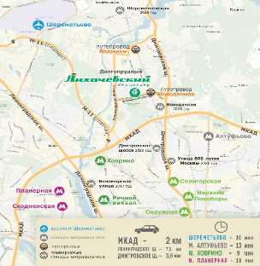
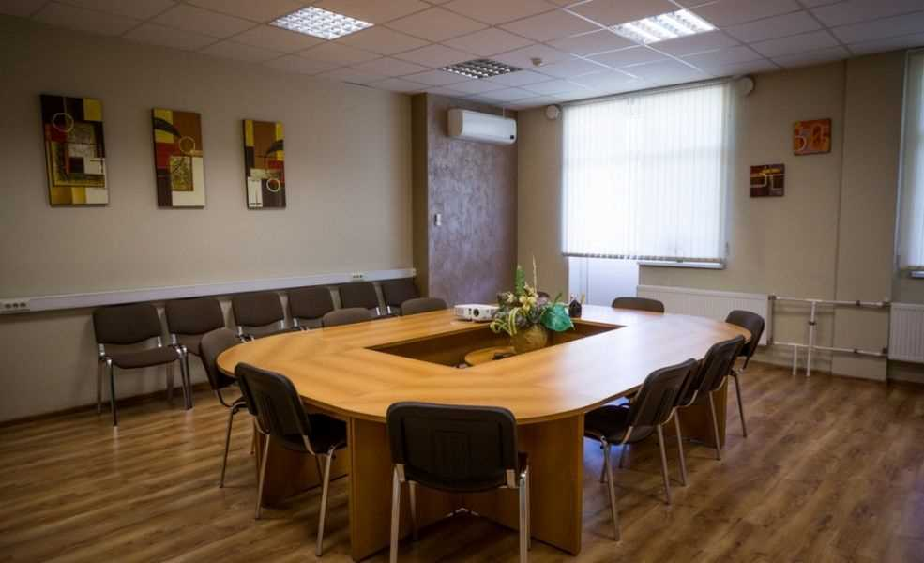
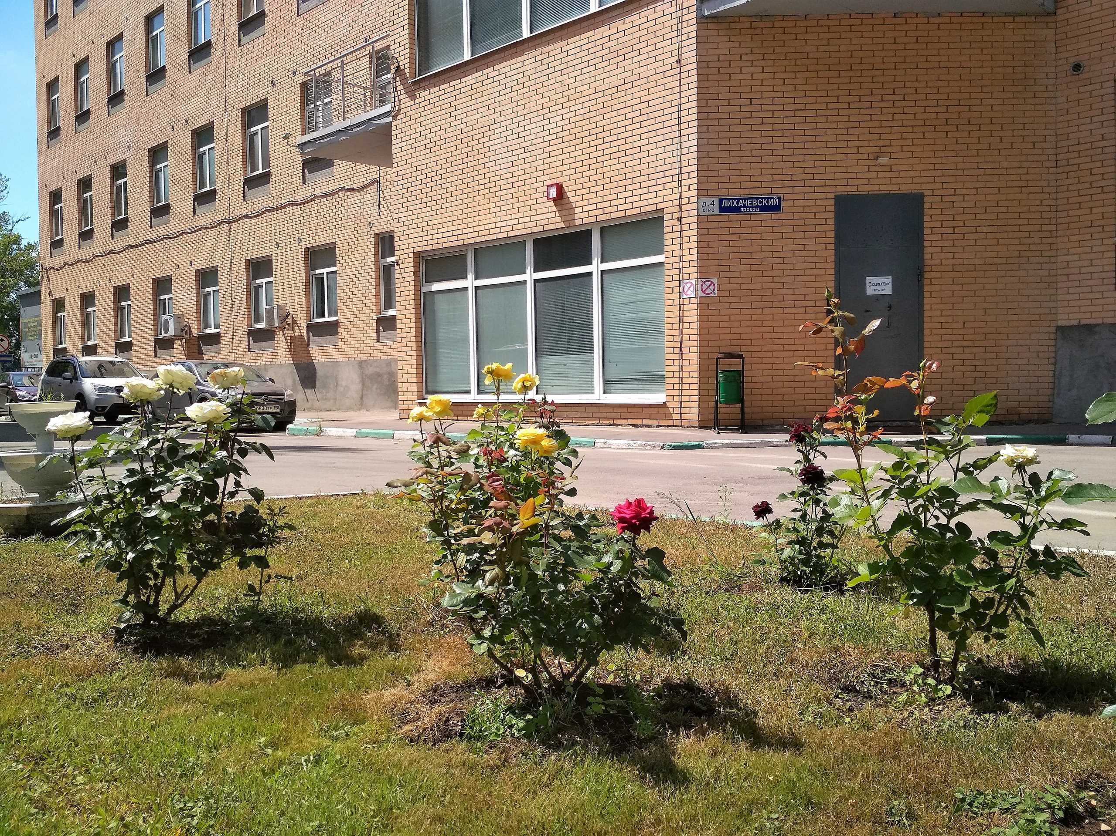
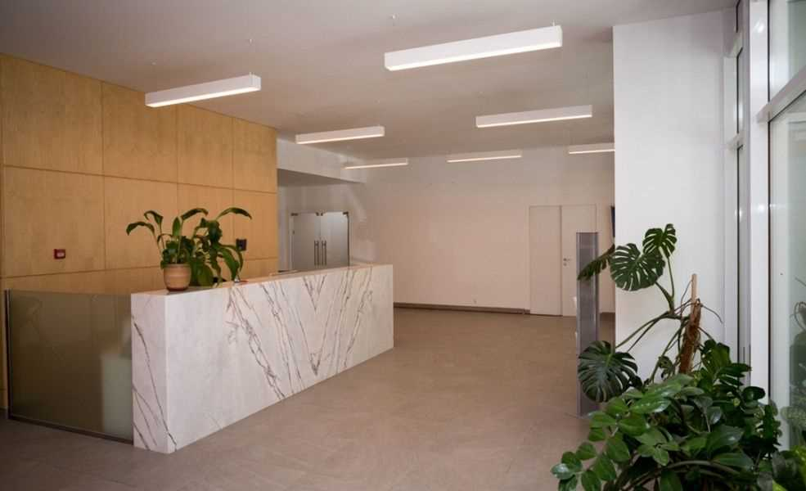
CITY DISTRICT DOLGOPRUDNY MOSCOW REGION
RENTAL PREMISES IN THE LIKHACHEVSKY TECHNOPARK
G . Dolgoprudny, Moscow region
TECHNOPARK "LIKHACHEVSKY "
large business complex , in which:
35,000 sq.m. area of ​​premises;
2000 jobs ;
200 residents;
300 parking spaces, 2 checkpoints,
cafe , car charging station ;
4 hectares of landscaped territory.
Advantages:
100 meters to MIPT;
1.25 sq. to the MCD station "Novodachnaya";
7.5 sq. to Leningradskoe highway;
8 kilometers. To the Khovrino metro station.
Management Company:
Technopark LLC, Vladimir Shalomeev
Phone: +7 (495) 579-96-70
E-mail: dolservice@list.ru
Rental and sales department:
Olga Likhosherst, + 7(495)765-05-79 ,
+7(985)765-05-79, ​linkinproject@yandex.ru
Elena Romanovskaya +7 (916) 060-61-53,
elena_r181@mail.ru
TECHNOPARK "Likhachevsky"
Address : 141700, Moscow region , Likha-
Chevsky proezd , 4 , building 1 ; d.6 , p. 1; d.8. Phone : +7 (495) 765-05-79
E-mail: linkinproject@yandex.ru
Website: http://lihachevsky.com/

Slide 18
CITY DISTRICT DOLGOPRUDNY MOSCOW REGION
Organizations of SME support infrastructure in the Moscow region
Name | Contacts | Functions
1. Ministry of Investment, Industry and Science of the Moscow Region | https://mii.mosreg.ru/kontakty | Formation and implementation of mechanisms of state support for SMEs: - organizing competitions for state support for SMEs - subsidies for entrepreneurs; - informing entrepreneurs about the implementation of state support programs; popularization of entrepreneurship.
2. ANO "Investment Development Agency of the Moscow Region" | https://invest.mosreg.ru/ | information and advice on state support for SMEs
3. Moscow Regional Microfinance Development Fund | https://www.mofmicro.ru/ | provision of microloans to SMEs of Moscow region
4. Moscow Regional Guarantee Fund | https://www.mosreg-garant.ru/ru/ | provision of guarantees for the obligations of SMEs and SME support infrastructure organizations of the Moscow Region
5. Ombudsman of the Moscow Region | https://www.golovnev.ru/ | protection of the rights and legitimate interests of entrepreneurs. Commissioner for the Protection of the Rights of Entrepreneurs of the Moscow Region - Vladimir Golovnev, e-mail: ombudsmenmo@ya.ru
6. Fund for Support of Foreign Economic Activity of the Moscow Region | https://exportmo.ru/ | facilitating the entry of Moscow region enterprises into foreign markets for goods, services and technologies; stimulation and involvement of business entities in export activities;
7. Center “My Business” (Dolgoprudny, Sobina Square, 3, 1st floor, room 105, tel. +7 (495) 4080518) | https://mb.mosreg.ru/content Center-"My-business" | Providing information, analytical, consulting support and a wide range of services to entrepreneurs in the Moscow region, as well as individuals planning to carry out business activities in the Moscow region and the self-employed. Assistance in obtaining government support measures.

Slide 19
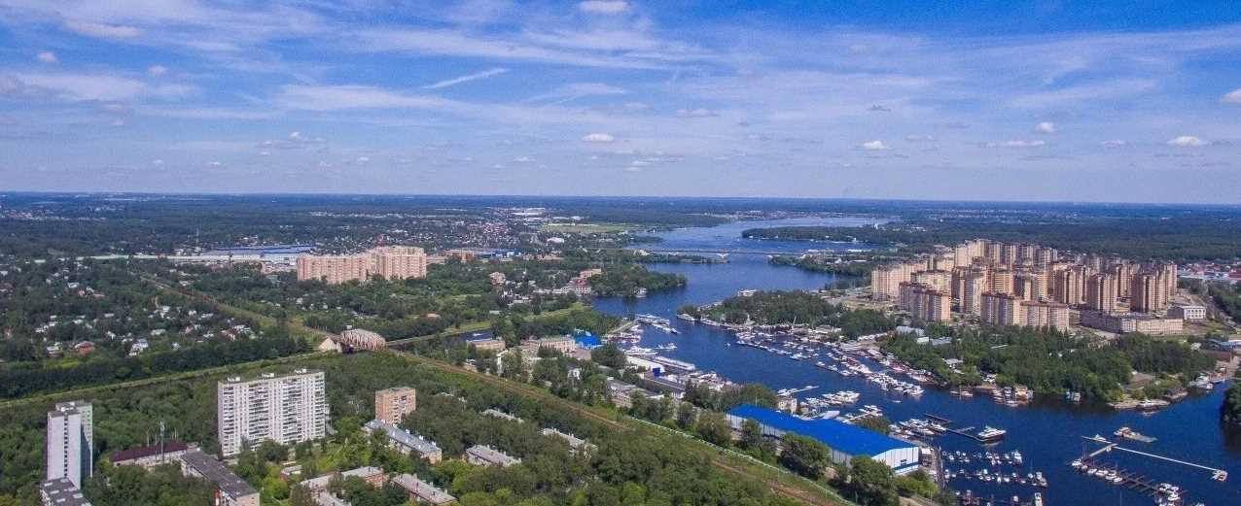
CITY DISTRICT DOLGOPRUDNY MOSCOW REGION
Offers for investors

Slide 20
CITY DISTRICT DOLGOPRUDNY MOSCOW REGION
Register of vacant real estate in municipal ownership *
List of non-residential premises in municipal ownership of the city. Dolgoprudny and not involved in economic turnover, posted on the investment portal of the Moscow region as of 12/06/2023
No. | Address | Area, sq.m. | Cadastral number | Link to investment portal | Note
1 | Moscow region, Dolgoprudny, st. Vostochnaya, 48 | 166 | 50:42:0010104:617 | https://invest.mosreg.ru/investor/catalog/bd3c500a-fe5e-41d1-9c82-23927c4282d0 | -
2 | Moscow region, Dolgoprudny, st. Vostochnaya, 50 | 110 | 50:42:0010104:619 | https://invest.mosreg.ru/investor/catalog/2037a42c-95a7-47cb-9c2b-afd54922b8dd | -
3 | Moscow region, Dolgoprudny, st. Oktyabrskaya. 16/8, room 14 | 54.4 | 50:42:0000000:67248 | https://invest.mosreg.ru/investor/catalog/1ca2a1cd-25e7-4a8d-ad5b-12f6d8c7e8fd | -
4 | Moscow region, Dolgoprudny, st. Pervomaiskaya, 15 | 514.6 | 50:42:0000000:84496 | https://invest.mosreg.ru/investor/catalog/5b062586-aba1-49da-a212-394f867ae8d6 | Included in the List for SMP
5 | Moscow region, Dolgoprudny, Moskovskoe sh.. D. 27a | 8.6 | 50:42:0000000:68403 | https://invest.mosreg.ru/investor/catalog/2ce8423b-f320-4176-958c-1dcb46a20fa0 | Included in the List for SMP
6 | Moscow region, Dolgoprudny, Pavlova str., 6 | 14.2 | 50:42:0000000:62505 | https://invest.mosreg.ru/investor/catalog/e97b6d66-6d02-4bc5-a4aa-c252ca2383cb | Included in the List for SMP
7 | Moscow region, Dolgoprudny, st. Dirizhabelnaya, 4, room. 5 | 32.5 | 50:42:0000000:80158 | https://invest.mosreg.ru/investor/catalog/57541301-e81b-49dd-ae27-0e4008ebe9eb | Included in the List for SMP
8 | Moscow region, Dolgoprudny, st. Dirizhabelnaya, 4, room. 5-8 | 63.4 | 50:42:0000000:77145 | https://invest.mosreg.ru/investor/catalog/e4c65396-36d6-48aa-88bd-e94ca6664977 | Included in the List for SMP
9 | Moscow region, Dolgoprudny, st. Tsiolkovskogo, 4 | 154.7 | 50:42:0000000:79653 | https://invest.mosreg.ru/investor/catalog/ef212a7b-4f35-44c8-80d8-604e01b1b0cd in the list | Included in the List for SMP
10 | Moscow region, Dolgoprudny, st. Vodniki, 15 | 412.2 | 50:42:0010104:309 | https://invest.mosreg.ru/investor/catalog/ce3498c7-f07e-4194-9900-2d14d032a6df | Included in the List for SMP
eleven | Moscow region, Dolgoprudny, st. Likhachevskoe highway, 13, bldg. 1 | 381.1 | 50:42:0000000:76803 | https://invest.mosreg.ru/investor/catalog/675bef90-2661-47b0-986b-aac0dc24f84e | Included in the List for SMP
12 | Moscow region, Dolgoprudny, st. Akademika Lavrentieva, 29 | 1312.4 | 50:42:0010310:10896 | https://invest.mosreg.ru/investor/catalog/357c0581-3e5d-40c5-8860-6407a81866e8 | Included in the List for SMP
13 | Moscow region, Dolgoprudny, Institutsky lane, 6 | 207.3 | 50:42:0000000:77664 | https://invest.mosreg.ru/investor/catalog/63a2db29-da4e-46c1-9fc1-bfa272654cc0 | Included in the List for SMP
14 | Moscow region, Dolgoprudny, st. Tsiolkovskogo, 4 | 184.7 | - | https://invest.mosreg.ru/investor/catalog/07e8e02e-dfeb-447c-a79a-ff77e3ce7b8d | Included in the List for SMP
15 | Moscow region, Dolgoprudny, st. Tsiolkovskogo, 6 | 384.8 | 50:42:0010230:379 | https://invest.mosreg.ru/investor/catalog/610a193e-83e9-491d-9714-847174bd9e1b | Included in the List for SMP
16 | Moscow region, Dolgoprudny, st. Dirigabelnaya, 6, bldg. 3, No. 1-No. 11 (5th floor), No. 1 (technical floor) | 300.8 | 50:42:0000000:78031 | https://invest.mosreg.ru/investor/catalog/32531b4d-66c8-45b2-9524-8ebb1e260b85 | Included in the List for SMP
17 | Moscow region, Dolgoprudny, Likhachevskoe highway, 13, bldg. 1, room 1 | 78.3 | 50:42:0000000:57318 | https://invest.mosreg.ru/investor/catalog/0bbb4158-bbbb-4aae-bb0e-31735154d314 | -
Electronic services for business
" Land for 1 ruble "
“Real estate for 1 ruble”
" Land Without Bidding "
" Real estate on the 1st-2nd floors of an apartment building "
" Start a business in the industrial park of the Moscow region."
You can select a land plot on the investment map ( https://invest.mosreg.ru/investor/map ) . It was created within the framework of the regional investment standard introduced in the Moscow region.
*The list of property intended to be provided to SMEs was approved by Resolution of the Administration of the Dolgoprudny City District No. 499-PA dated August 25, 2023 (posted on the website:
https : //of-dolgoprudny.rf/dokumenty/normativnye-akty-2020/ _ _

Slide 21
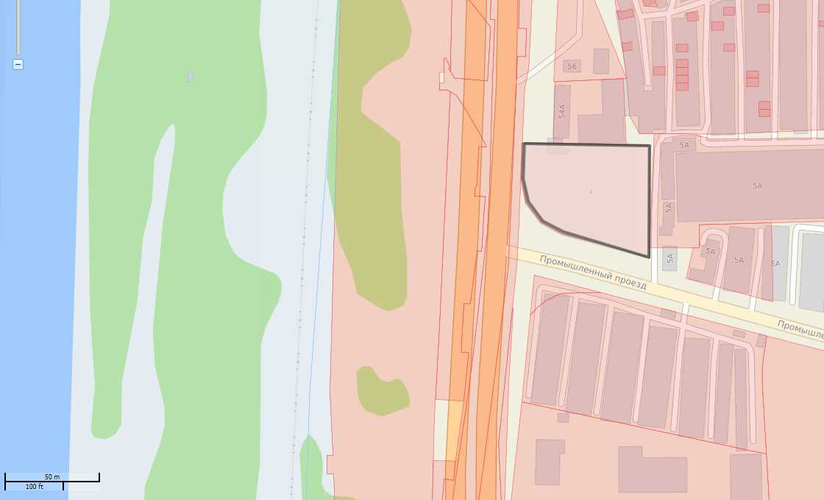
CITY DISTRICT DOLGOPRUDNY MOSCOW REGION
Promising land plots for investment
Offer for investors
LAND
Cadastral number: 50:42:0020104:211
    ENGINEERING AND TECHNICAL SUPPORT
    Gas supply: 15 cubic meters m/hour. Gas pipeline JSC "Flint-K" connection point on the street. Industrial passage. Connection period is 1 year. The cost of connection is in accordance with Order No. 451-r dated December 20, 2019.
    Water supply: 5 cubic meters m/hour connection point In the area of Likhacheskoye Highway or Promyshlenny Proezd. Connection period is 18 months. The amount of the connection fee, see order No. 315-r dated December 20, 2017
    Drainage: 5 cubic meters m/hour connection point In the area of Industrial passage. Connection period is 18 months. For the connection fee, see order No. 316-r dated December 20, 2017.
    Heat supply: 0 Gcal/hour It is necessary to build your own boiler house
    Electric power : 670 kW Substation-Dolgoprudnaya, Connection period from 4 months. -1 year. For the amount of connection fees, see order No. 347-r dated December 27, 2017
Cadastral number: 50:42:0020104:211
https:// invest.mosreg.ru/investor/catalog/e670e154-6373-4bfe-9e19-86583d819106
Address: Moscow region, Dolgoprudny, intersection of Likhachevskoye highway and Promyshlenny passage
Area : 0.34 hectares
category : Lands of populated areas
Type of permitted use: Roadside service facilities
Type of ownership: Municipal
SPZ: 50 m
Cadastral value: RUB 27,611,094.00.
Transport accessibility: distance to MKAD: 4 km ;
to the Central Ring Road : 28 km

Slide 22
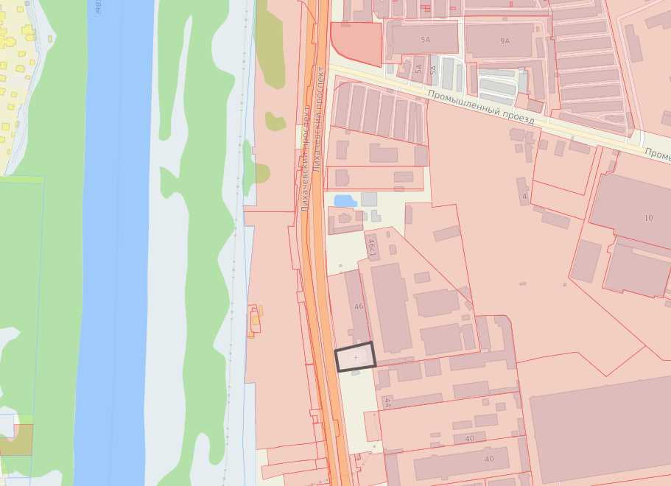
CITY DISTRICT DOLGOPRUDNY MOSCOW REGION
Promising land plots for investment
Offer for investors
LAND
Cadastral number: 50:42:0020104:74
    ENGINEERING AND TECHNICAL SUPPORT
    Gas supply: 15 cubic meters m/hour GDS “KRP-13 (CHP-21)” Connection period from 4 months. -1 year. The cost of connection is in accordance with Order No. 451-r dated December 20, 2019.
    Water supply: 5 cubic meters m/hour connection point In the area of Likhacheskoye Highway or Promyshlenny Proezd. Connection period is 18 months. The amount of the connection fee, see order No. 315-r dated December 20, 2017
    Drainage: 5 cubic meters m/hour connection point In the area of Industrial passage. Connection period is 18 months. For the connection fee, see order No. 316-r dated December 20, 2017 .
    Heat supply: 0 Gcal/hour It is necessary to build your own boiler house
    Electric power : 670 kW Substation-Dolgoprudnaya, Connection period from 4 months. -1 year. For the amount of connection fees, see order No. 347-r dated December 27, 2017
Cadastral number: 50
Address: Moscow region, Dolgoprudny, Likhachevsky Ave. , near 46a
Area : 0.15 ha
category : Lands of populated areas
Type of permitted use: For the placement of a non-capital trade pavilion (without a foundation) for trade in hardware Type of ownership: Municipal
SPZ: 50 m
Cadastral value: RUB 16,150,230.00 .
Transport accessibility: distance to MKAD: 4 km ;
to the Central Ring Road : 28 km

Slide 23
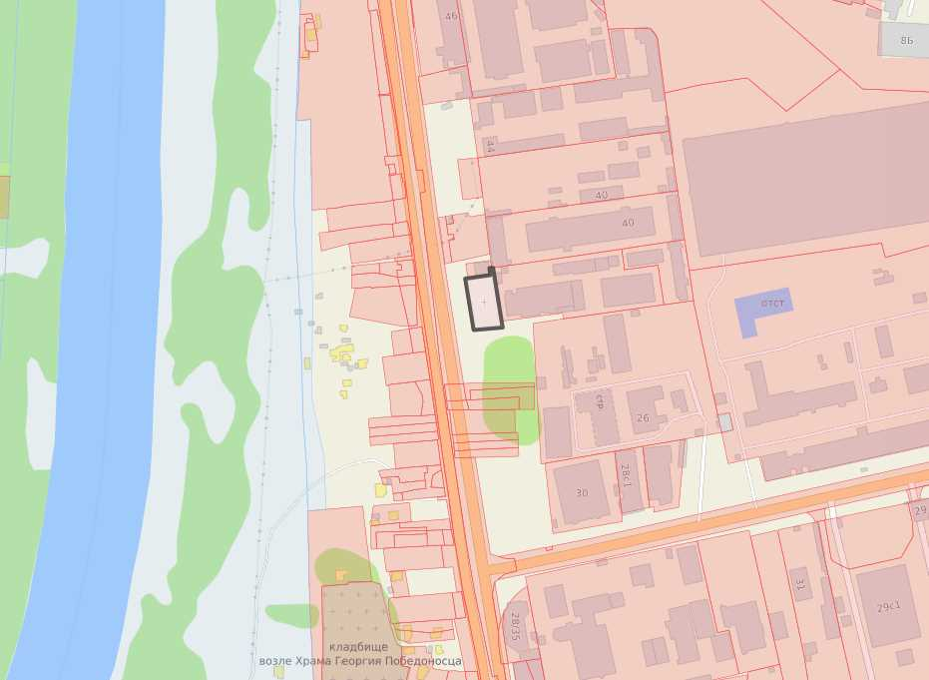
CITY DISTRICT DOLGOPRUDNY MOSCOW REGION
Promising land plots for investment
Offer for investors
LAND
Cadastral number: 50:42:0020104:25
    ENGINEERING AND TECHNICAL SUPPORT
    Gas supply: 15 cubic meters m/hour GDS “KRP-13 (CHP-21)” Connection period from 4 months. -1 year. The cost of connection is in accordance with Order No. 451-r dated December 20, 2019.
    Water supply: 5 cubic meters m/hour connection point In the area of Likhacheskoye Highway or Promyshlenny Proezd. Connection period is 18 months. The amount of the connection fee, see order No. 315-r dated December 20, 2017
    Drainage: 5 cubic meters m/hour connection point In the area of Industrial passage. Connection period is 18 months. For the connection fee, see order No. 316-r dated December 20, 2017 .
    Heat supply: 0 Gcal/hour It is necessary to build your own boiler house
    Electric power : 670 kW Substation-Dolgoprudnaya, Connection period from 4 months. -1 year. For the amount of connection fees, see order No. 347-r dated December 27, 2017
Cadastral number: 50:42:0020104:25 https:// invest.mosreg.ru/investor/catalog/9e9a8af8-7d36-4efb-a43a-e8eca6b88dd7
Address: Moscow region, Dolgoprudny,
Likhachevsky Ave.
Area : 0.1534 ha
category : Lands of populated areas
Type of permitted use: For the construction and placement of a shopping complex
Type of ownership: Municipal
SPZ: 50 m
Cadastral value: RUB 16,639,436.06.
Transport accessibility: distance to the nearest federal highway: 4 km

Slide 24
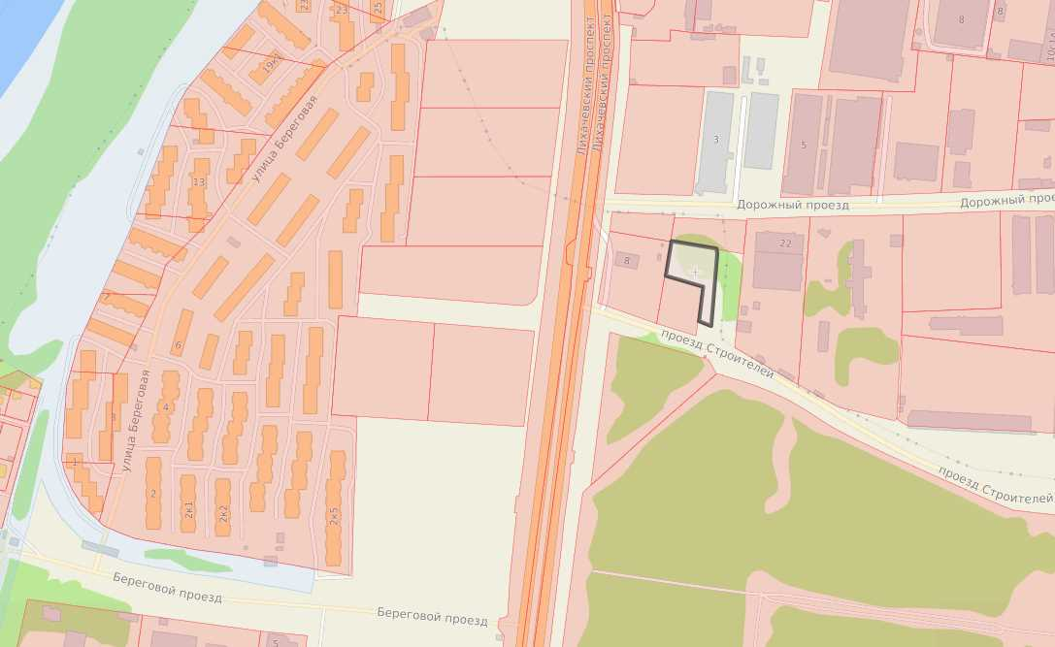
CITY DISTRICT DOLGOPRUDNY MOSCOW REGION
Promising land plots for investment
Offer for investors
LAND
Cadastral number: 50:42:0020201:847
    ENGINEERING AND TECHNICAL SUPPORT
    Gas supply: 15 cubic meters m/hour GDS “KRP-13 (CHP-21)” Connection period from 4 months. -1 year. The cost of connection is in accordance with Order No. 451-r dated December 20, 2019.
    Water supply: 5 cubic meters m/hour connection point In the area of Likhacheskoye Highway or Promyshlenny Proezd. Connection period is 18 months. The amount of the connection fee, see order No. 315-r dated December 20, 2017
    Drainage: 5 cubic meters m/hour connection point In the area of Industrial passage. Connection period is 18 months. For the connection fee, see order No. 316-r dated December 20, 2017 .
    Heat supply: 0 Gcal/hour It is necessary to build your own boiler house
    Electric power : 670 kW Substation-Dolgoprudnaya, Connection period from 4 months. -1 year. For the amount of connection fees, see order No. 347-r dated December 27, 2017
Cadastral number: 50:42:0020201:847
https:// invest.mosreg.ru/investor/catalog/027f3b3b-b1f4-4211-b4b4-8fe809681eee
Address: Moscow region, Dolgoprudny,
Proezd Builders
Area : 0.2352
category : Lands of populated areas
Type of permitted use: For housing and communal services facilities
Type of ownership: Undelimited state property
SPZ: 50 m
Cadastral value: 12,783,590.40 rubles.
Transport accessibility: distance to MKAD:
3 km; to the Central Ring Road : 32 km

Slide 25
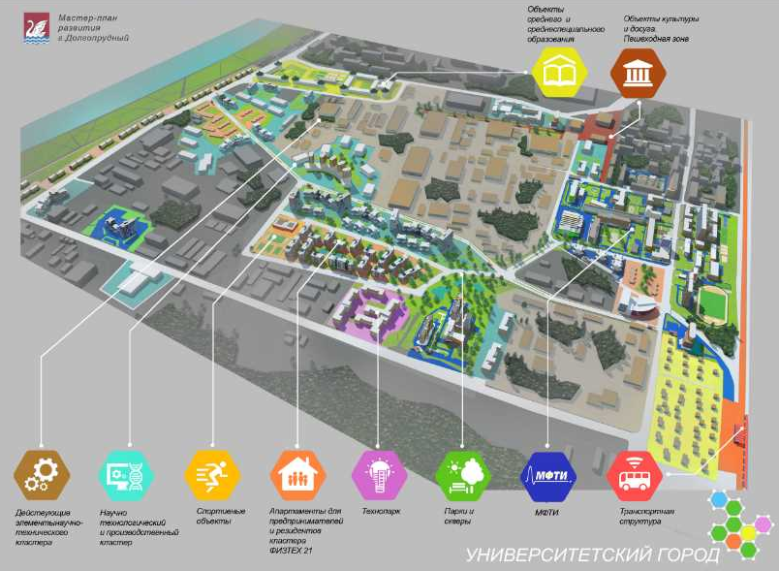
CITY DISTRICT DOLGOPRUDNY MOSCOW REGION
Dot height #1
DEVELOPMENT OF THE SOUTHERN PART OF THE CITY AS A “UNIVERSITY CITY ”
The goal of the “University City ” project based on MIPT
Involvement of unused land plots of federal, regional and municipal property into circulation in order to create an educational, scientific and business space for companies in the field of high technologies, focused on the human resources potential of Physics and Technology
By 2030 it is planned:
increase the number of students from about 8 thousand to 9.9 thousand people,
funding for research and development work (R&D) is expected to increase to 10 billion rubles per year (an increase of 2.5 times);
The university intends to enter the top 10 of the world THE ranking for physical sciences, the top 25 for computer science and mathematics, and take a leading position in the ranking of “entrepreneurial” universities in Russia .
to create on the basis of MIPT laboratories, specialized consortia and cooperation , including with leading international universities and research centers.
In addition, the university intends to develop and implement at least 20 professional retraining programs with leading companies in the digital economy in areas such as artificial intelligence, data engineering, data analysis, machine learning, and programming .
MIPT plans:
launching educational startups;
creation of a student technology park and business incubator with international partners;
development of EdTech direction;
Formation of a “Campus of the Future” on the campus in Dolgoprudny to support startups.

Slide 26
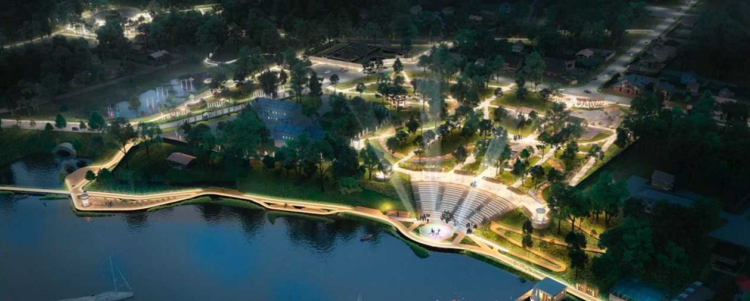
CITY DISTRICT DOLGOPRUDNY MOSCOW REGION
Dot growth # 2
Central Park
culture and recreation in the city of Dolgoprudny
The park includes several separate park areas: central park, Mysovo park, Yusupovsky square, park on Molodezhnaya street, Kotovsky Bay embankment, New Vodniki park, Dolgov square, square on Dirizhabelnaya street, Stroiteley Square.
DEVELOPMENT OF TOURIST AND RECREATIONAL ZONE
The goal of the project “Dolgoprudny is a high-flying city!”
Creating conditions for recreation and health improvement for residents and guests of the city,
creating jobs in tourism, trade and tourism services
Increasing the influx of tourists to the urban district and region to 280 thousand people per year
In 2024, as part of the regional program for the development and improvement of the urban environment, the reconstruction of park areas is envisaged: repair of street lighting, installation of new recreational facilities, sports grounds, public catering pavilions, landscaping. An eco-trail will appear along the Moscow Canal , a bicycle path will be equipped for cyclists, connected to the cycle track in Khimki, and new functional areas will appear, incl. for barbecue, yoga. The entire territory of the park will be covered with video surveillance with integration into the “Safe Region ” system.
Picturesque area of 20 hectares, Distance 6 km from Moscow Website http://dolpark.ru /

Slide 27
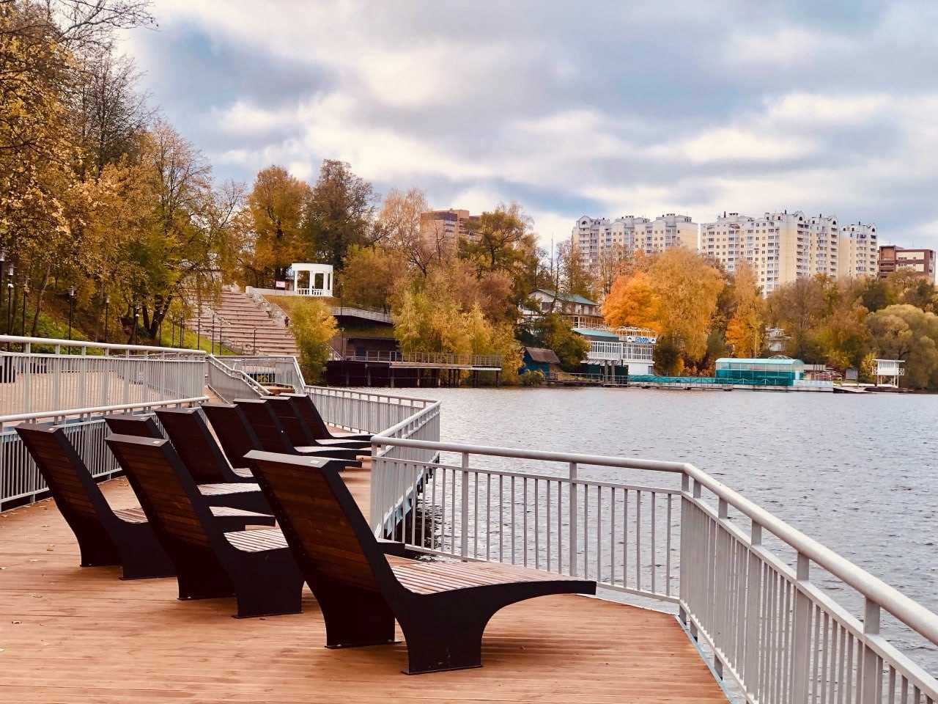
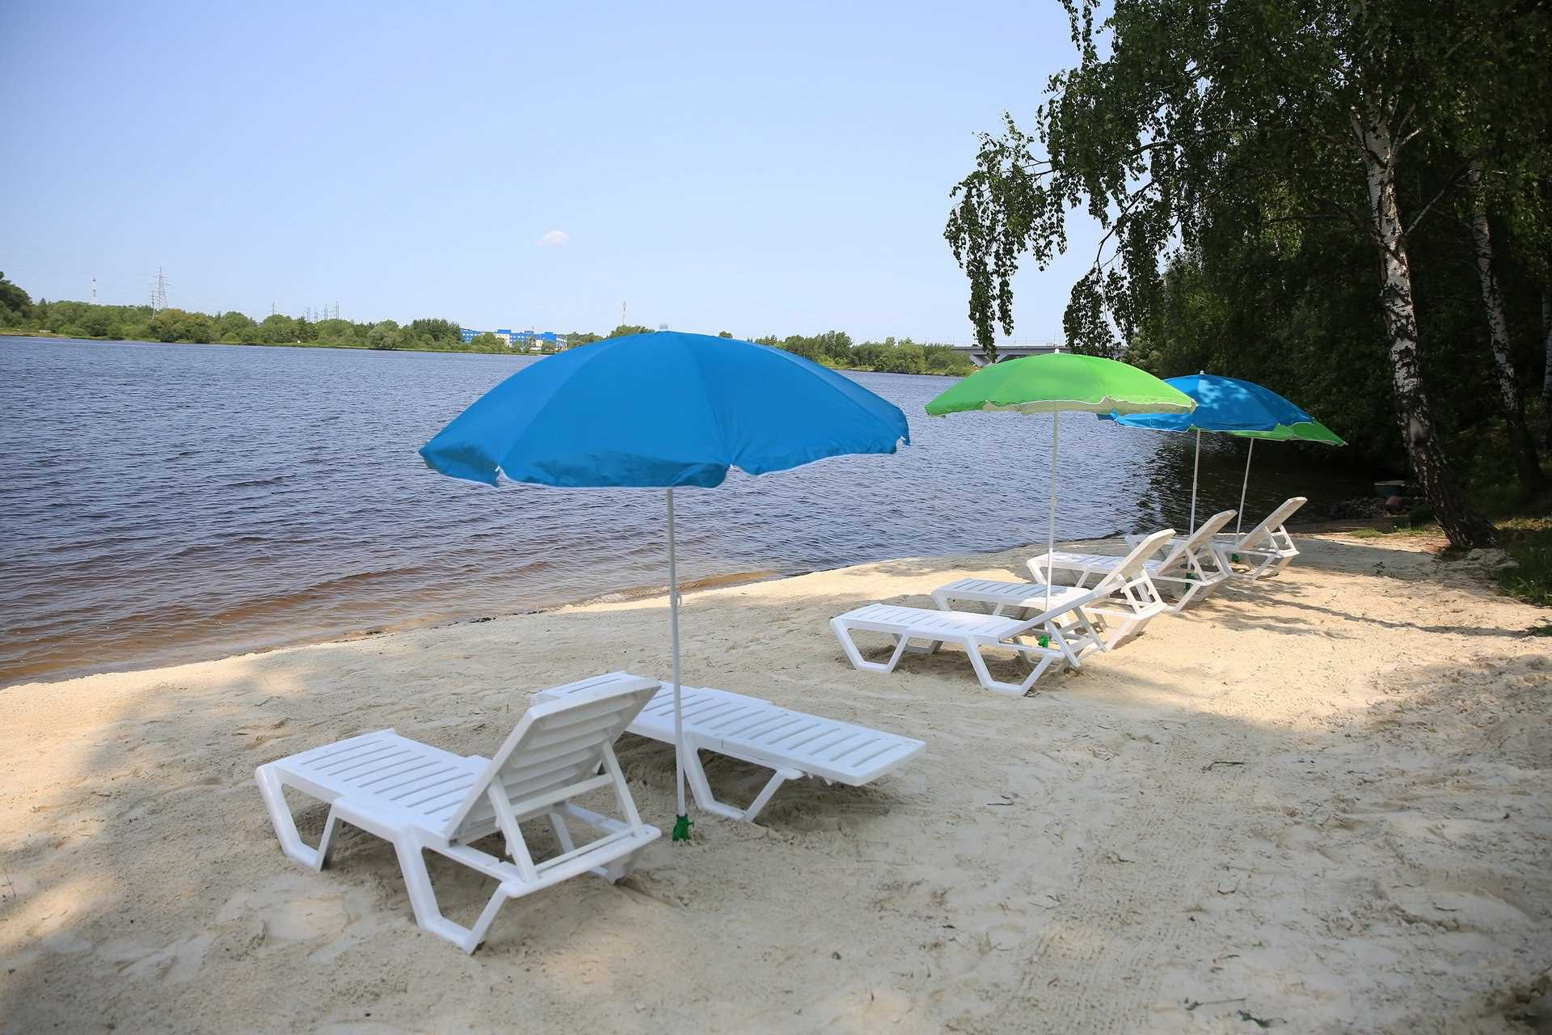
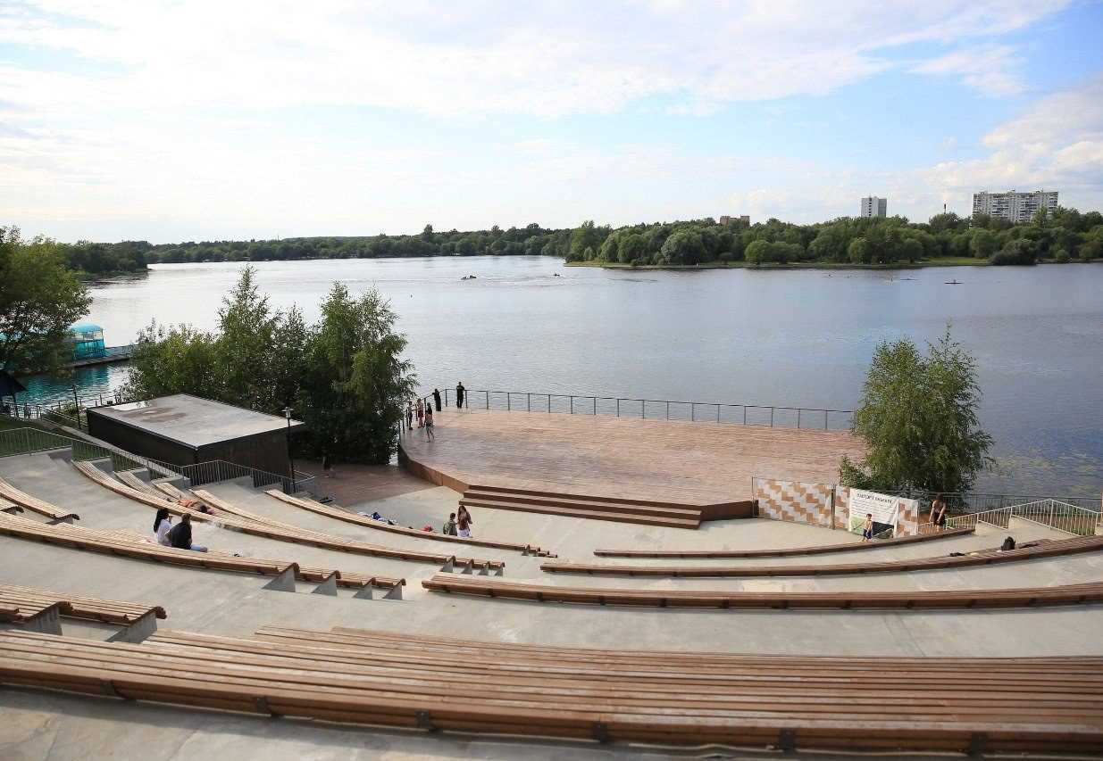
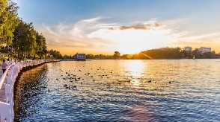
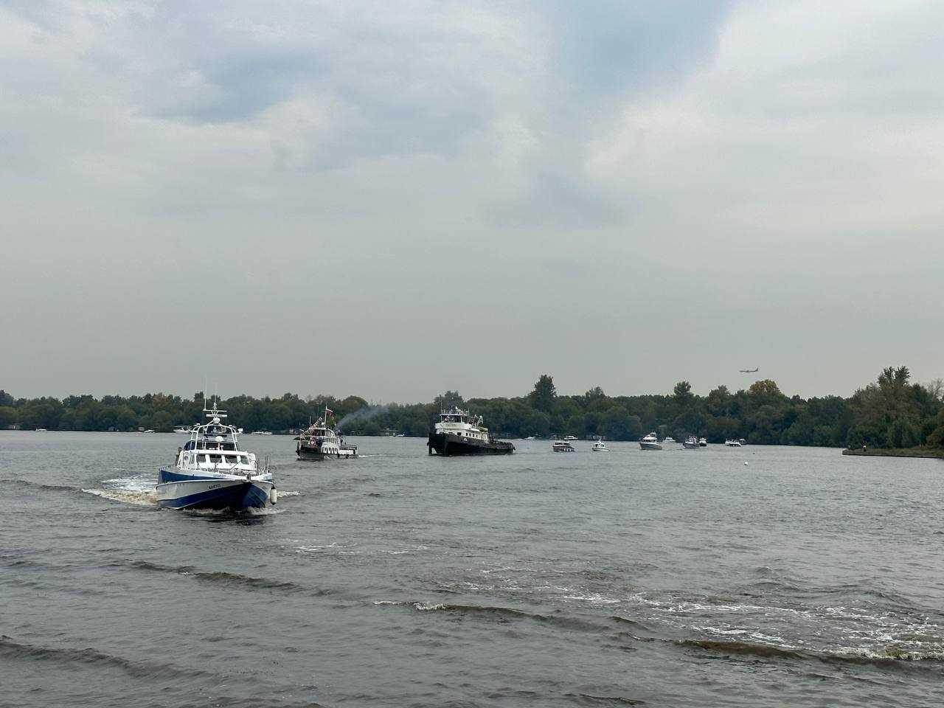
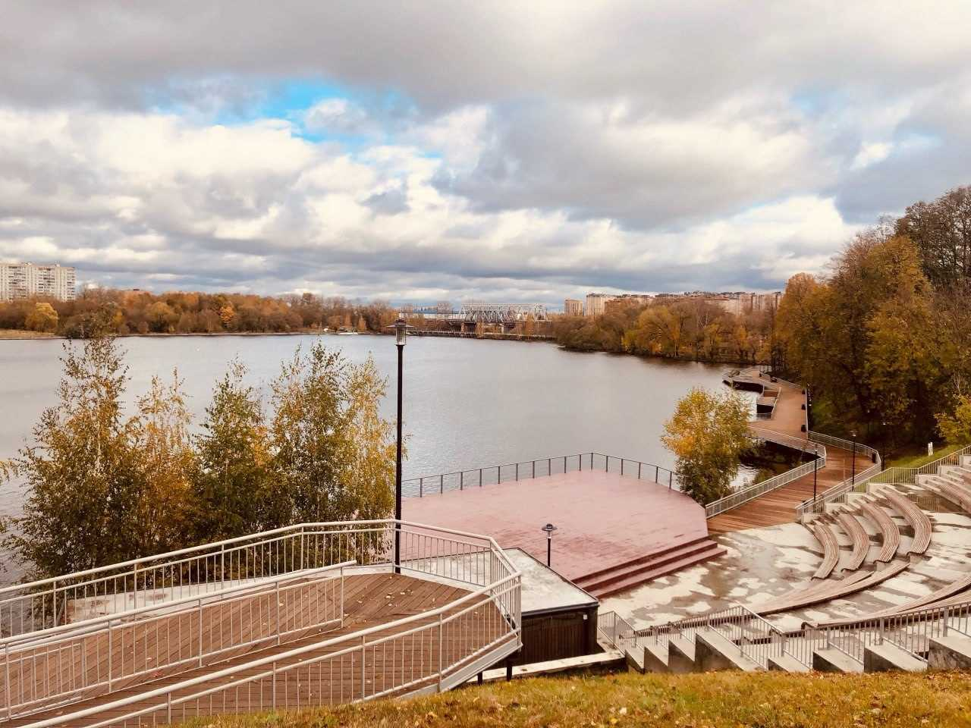
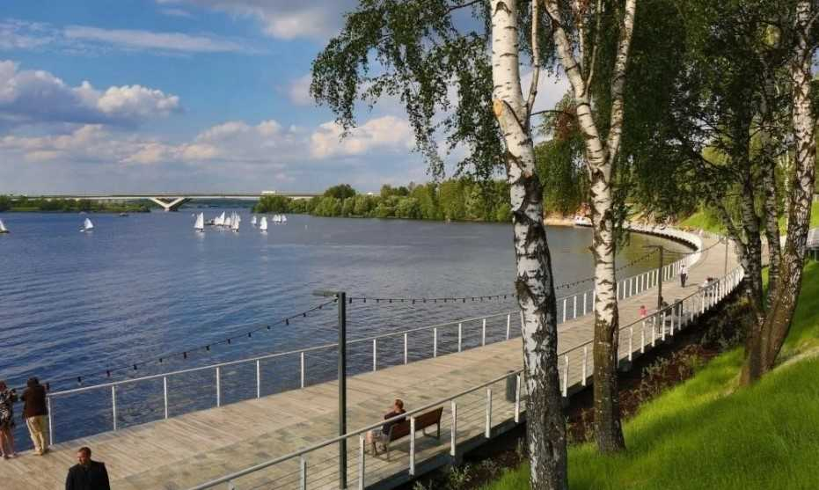
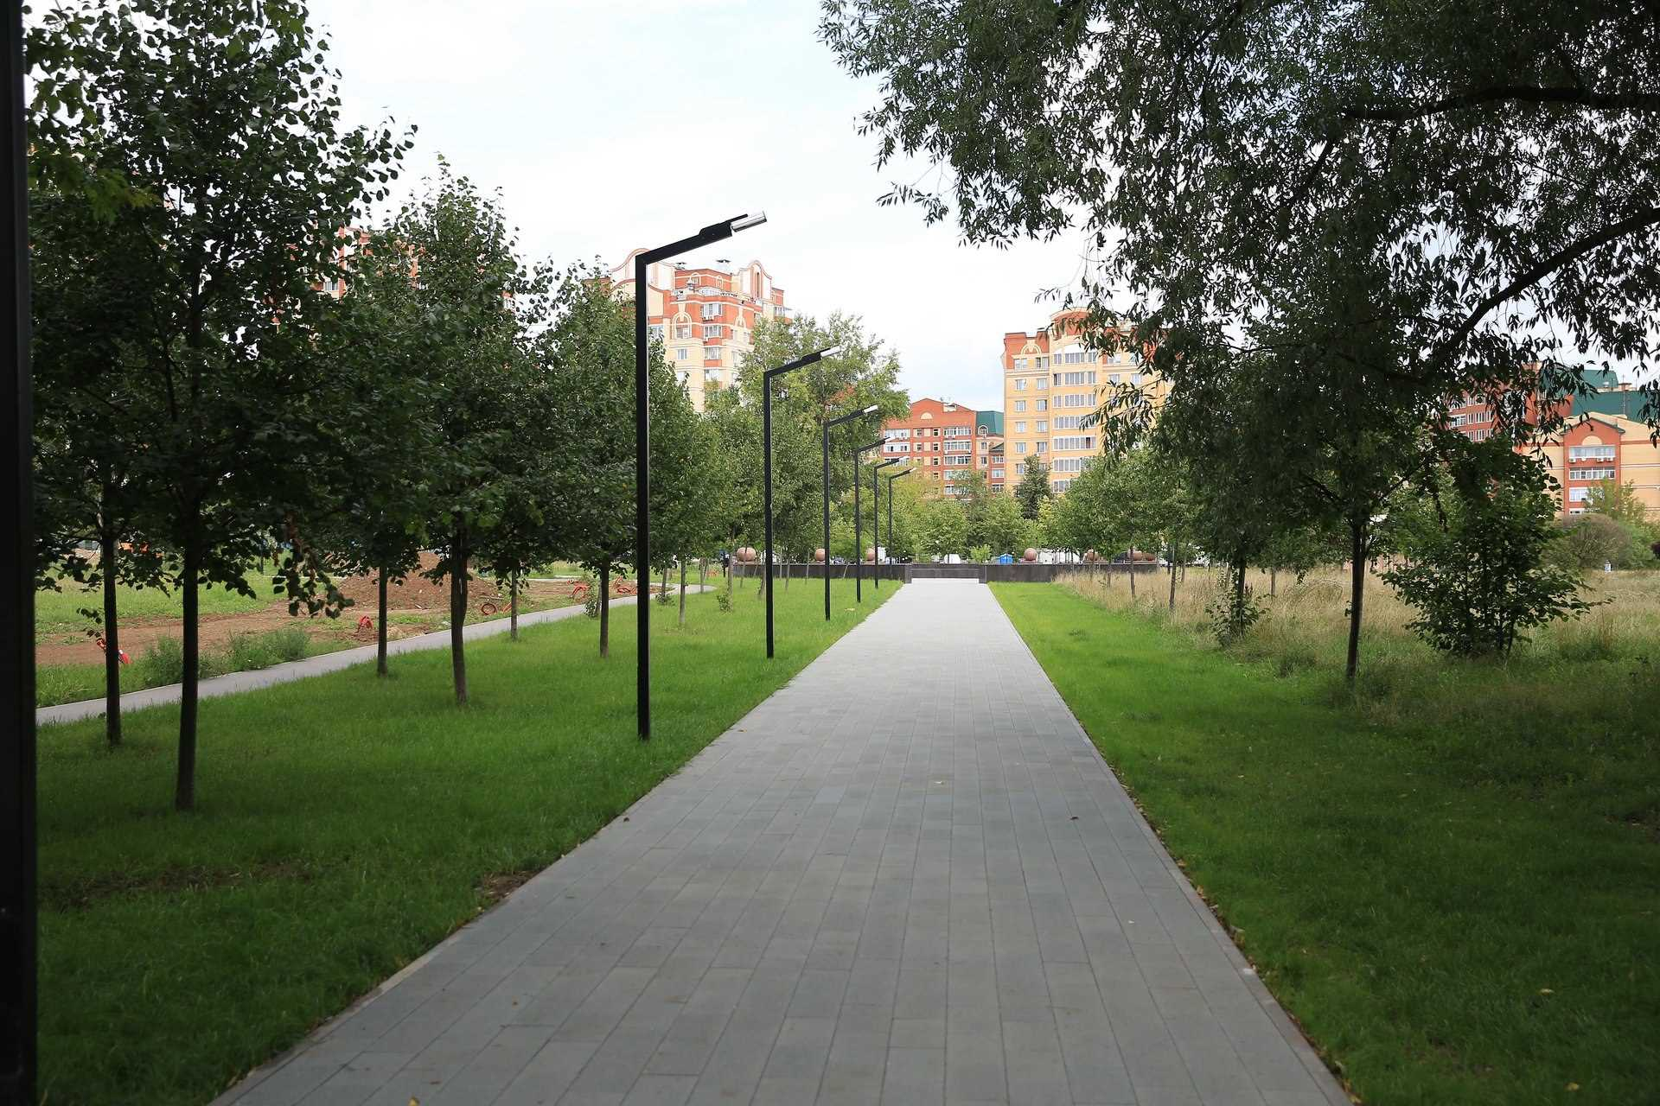
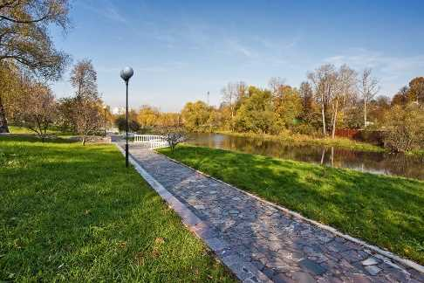
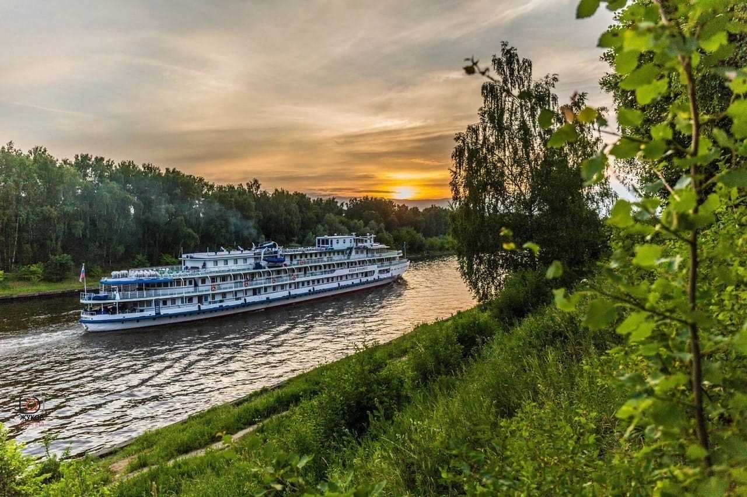
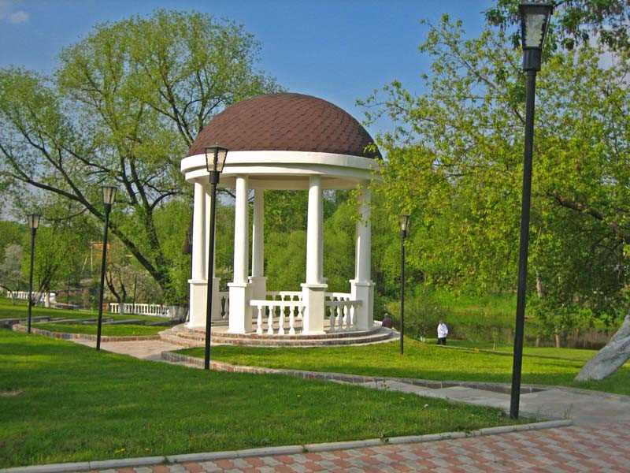
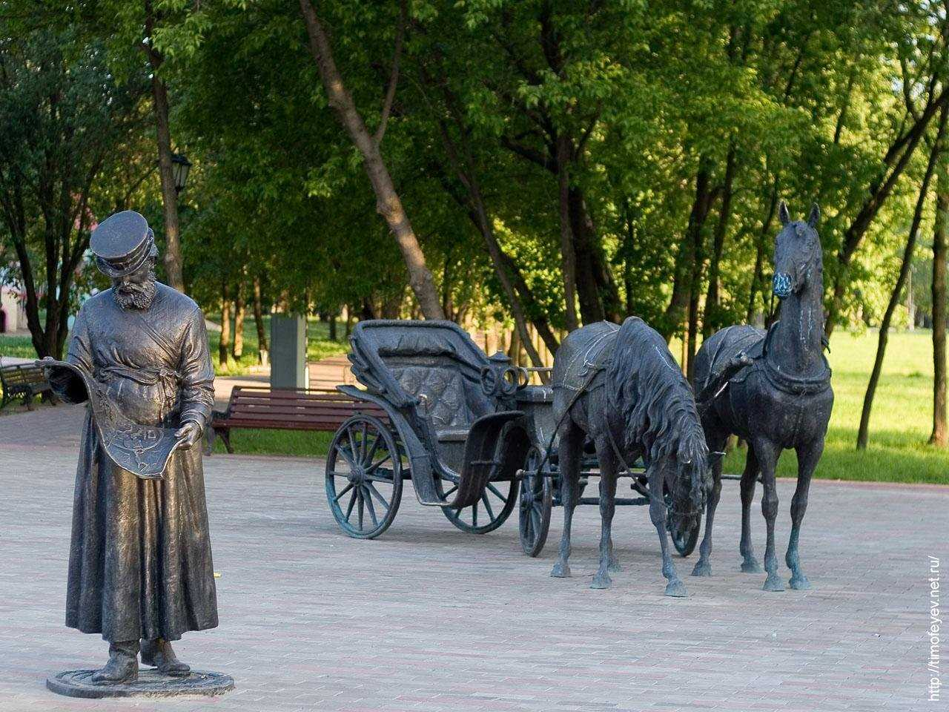
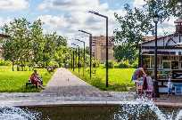
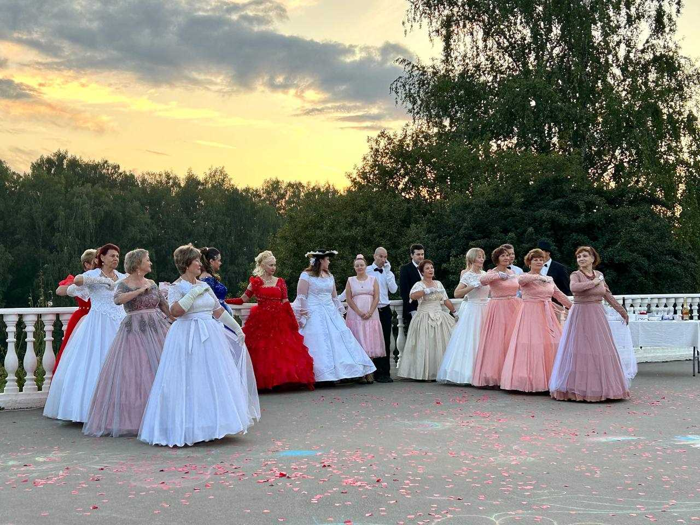
CITY DISTRICT DOLGOPRUDNY MOSCOW REGION
PARKS AND RECREATION AREAS
Dolgoprudny . Yusupovsky Square, Amphitheater on Kotovsky Bay, parade of ships
PARK microdistrict New Vodniki city Dolgoprudny
Rotunda in the park of Dolgoprudny
Central PARK city Dolgoprudny
PARK on the street Youth city district Dolgoprudny

Slide 28
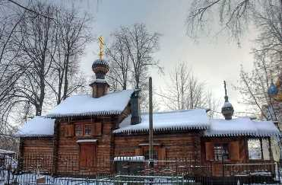
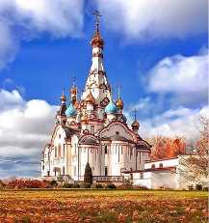







CITY DISTRICT DOLGOPRUDNY MOSCOW REGION
St. George's Church (wooden), 1774, microdistrict. Southern
Temple of the Icon of the Mother of God of Kazan
Chapel of St. George the Victorious
Temple of the Savior Not Made by Hands, 1884
Estate "Kotovo-Spasskoye"
HISTORICAL AND CULTURAL HERITAGE
Church of the Transfiguration of the Lord
Church of Sergei of Radonezh, 1893
Temple of the Icon of the Mother of God of Kazan
Temple of the Icon of the Mother of God Recovering the Lost
Estate "Kuznetsov : main house" late 19th century.

Slide 29











CITY DISTRICT DOLGOPRUDNY MOSCOW REGION
Industrial tourism
Ice cream factory
"Clean line"
on delicious educational excursions
for children and adults
Dolgoprudny Historical and Art Museum
The museum exhibits
Aeronautics and airship construction
1932 - 1937. History of the construction of the Moscow-Volga canal and many others
The museum is not only a custodian of history, but also a cultural center. The museum regularly hosts art exhibitions, presentations of books by Dolgoprudny authors, and creative evenings
On the central alley of the Park of Culture and Recreation, the installation of two outdoor exhibitions connecting Italy and Russia has been completed*. The first of them is “Soviet partisans in Italy. 1942-1945", the second - "Umberto Nobile - Italian airship pilot and Arctic explorer in Dolgoprudny."
* Exhibitions were prepared by the Russian Historical Society, the History of the Fatherland Foundation, the Dolgoprudny Historical and Art Museum, the Dante Alighieri Society in Moscow and Rome and the International Youth Society “Amichi Friendship” Italy-Russia.

Slide 30

CITY DISTRICT DOLGOPRUDNY MOSCOW REGION
Infrastructure to support investment activities
Application of ASI best practices that improve work with entrepreneurs and investors
Availability of direct communication channels between investors and municipal management
Availability of an Investment Council
Support of investment projects
Municipal business support (competitions, subsidies)
Consulting, methodological, information support
Availability of accessible infrastructure (industrial park , industrial sites, business centers, coworking spaces, etc. )
The Standard for the activities of local governments to ensure a favorable investment climate

Slide 31

CITY DISTRICT DOLGOPRUDNY MOSCOW REGION
INFORMATION FOR INVESTORS
Official site:
http://www.dolgoprudny.com/
Administration of the urban district of Dolgoprudny, Moscow region
141700, Moscow region,
Dolgoprudny, Sobin Square, 3
Job title | Full name | Make an appointment | Email
Head of the city district | Vladislav Yurievich Yudin | 8(495) 576-45-88 8(495) 408-72-00 | glava@dolgoprudny.com dolgo@mosreg.ru
Deputy Head of Administration (on economics and finance, land issues) | Lidia Mikhailovna Grishina | 8 (495)576-53-09 8 ( 495)408-51-99 | lidagrihina@mail.ru e conom.oer@dolgoprudny.com
Deputy Head of Administration (on construction issues) | Kozhinov Andrey Grigorievich | 8(495) 576-95-86 | andreikozhinov63@mail.ru
Deputy Head of Administration ( on architecture issues ) | Muravyov Oleg Dmitrievich | 8(495) 408-26-94 | odmur@mail.ru

Slide 32



CITY DISTRICT DOLGOPRUDNY MOSCOW REGION
LEADING CITY MEDIA
Internet
Official website of the administration of the Dolgoprudny urban district
Phone : + 7 ( 495)408-72-00, +7 (495) 576-84-84
Website: http:// of-dolgoprudny.rf
E-mail : dolgo@mosreg.ru
TV channel
Address: 141707 , Moscow Region, Dolgoprudny ,
st . Tsiolkovskogo, 4
Phone : + 7 (495) 576- 35 - 54
Website: http://dolgoprudnymedia.ru/ _ _
E-mail : tv@dolgoprudnymedia.ru
TV channel "Dolgoprudny"
Telegram channels:
Head of the Dolgoprudny urban district
official page of the administration of the city of Dolgoprudny
"Official Dolgoprudny"
Address : https://t.me/yudinvladislav _
Address : https://t.me/dolgoprudnyof _ _

Slide 33


CITY DISTRICT DOLGOPRUDNY MOSCOW REGION
Dolgoprudny is a high-flying city!
A city with a rich history, huge scientific and production potential and a strong future!
You can send your proposals for investment development to the address: 141700 , Moscow region, Dolgoprudny, pl. Sobina, 3, Administration of the Dolgoprudny urban district, Moscow region dolgo@mosreg.ru or to the email of the Economic Development Department of the Economics Department of the Dolgoprudny City District Administration econom_dol@mail.ru

